Slide 1







Cummins ISPM 15 Internal Training
Notes:
Hello and welcome to the ispm 15 training, I am Sophie and I will be taking you through this training. We will be taking a look at what ISPM 15 is and how this impacts Cummins.

Slide 2


ISPM 15 Training Aims
  What is ISPM 15?
  What packaging is in scope?
  ISPM 15 stamp requirements
  Wood treatments
  Pallet reuse
  Test your knowledge.
  Build your own compliant pallet
Notes:
The aims of this training are as follows: firstly we will take a look at what ispm 15 is, we will then understand what packaging is in scope

Slide 3


ISPM 15 Overview
What is ISPM 15?
The ISPM 15 standard describes phytosanitary measures that reduce the risk of introduction and spread of quarantine pests through wood packaging.
What are phytosanitary measures?
Rules, measures and regulations in place to protect human, animal and plant life from risk arising from contaminants, toxins or disease-causing organisms.
Who does this apply to at Cummins?
Packaging
Operators
HSE
Material Handlers
Purchasing
Notes:
What is phytosanitary – done

Slide 4
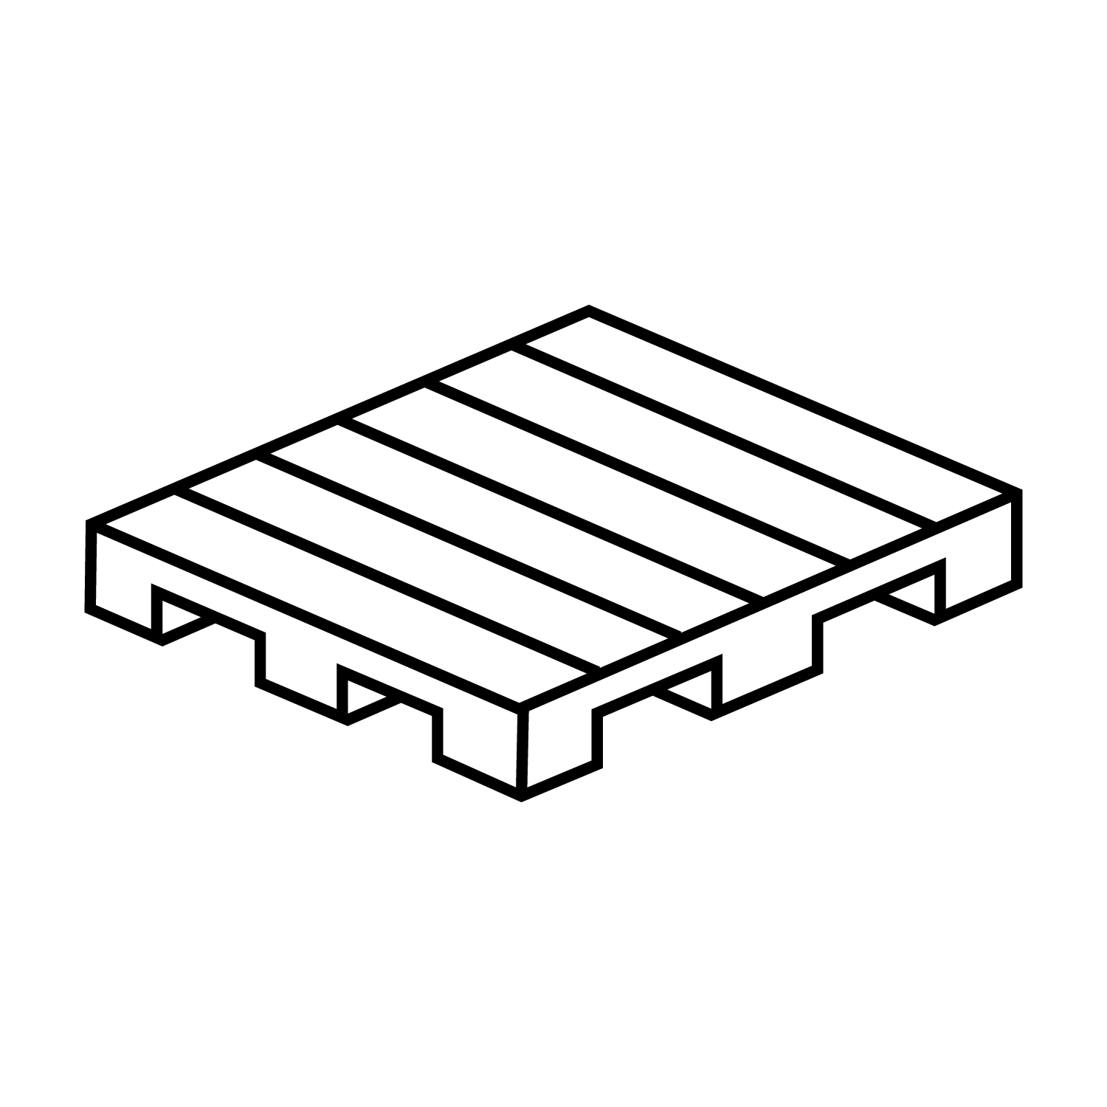
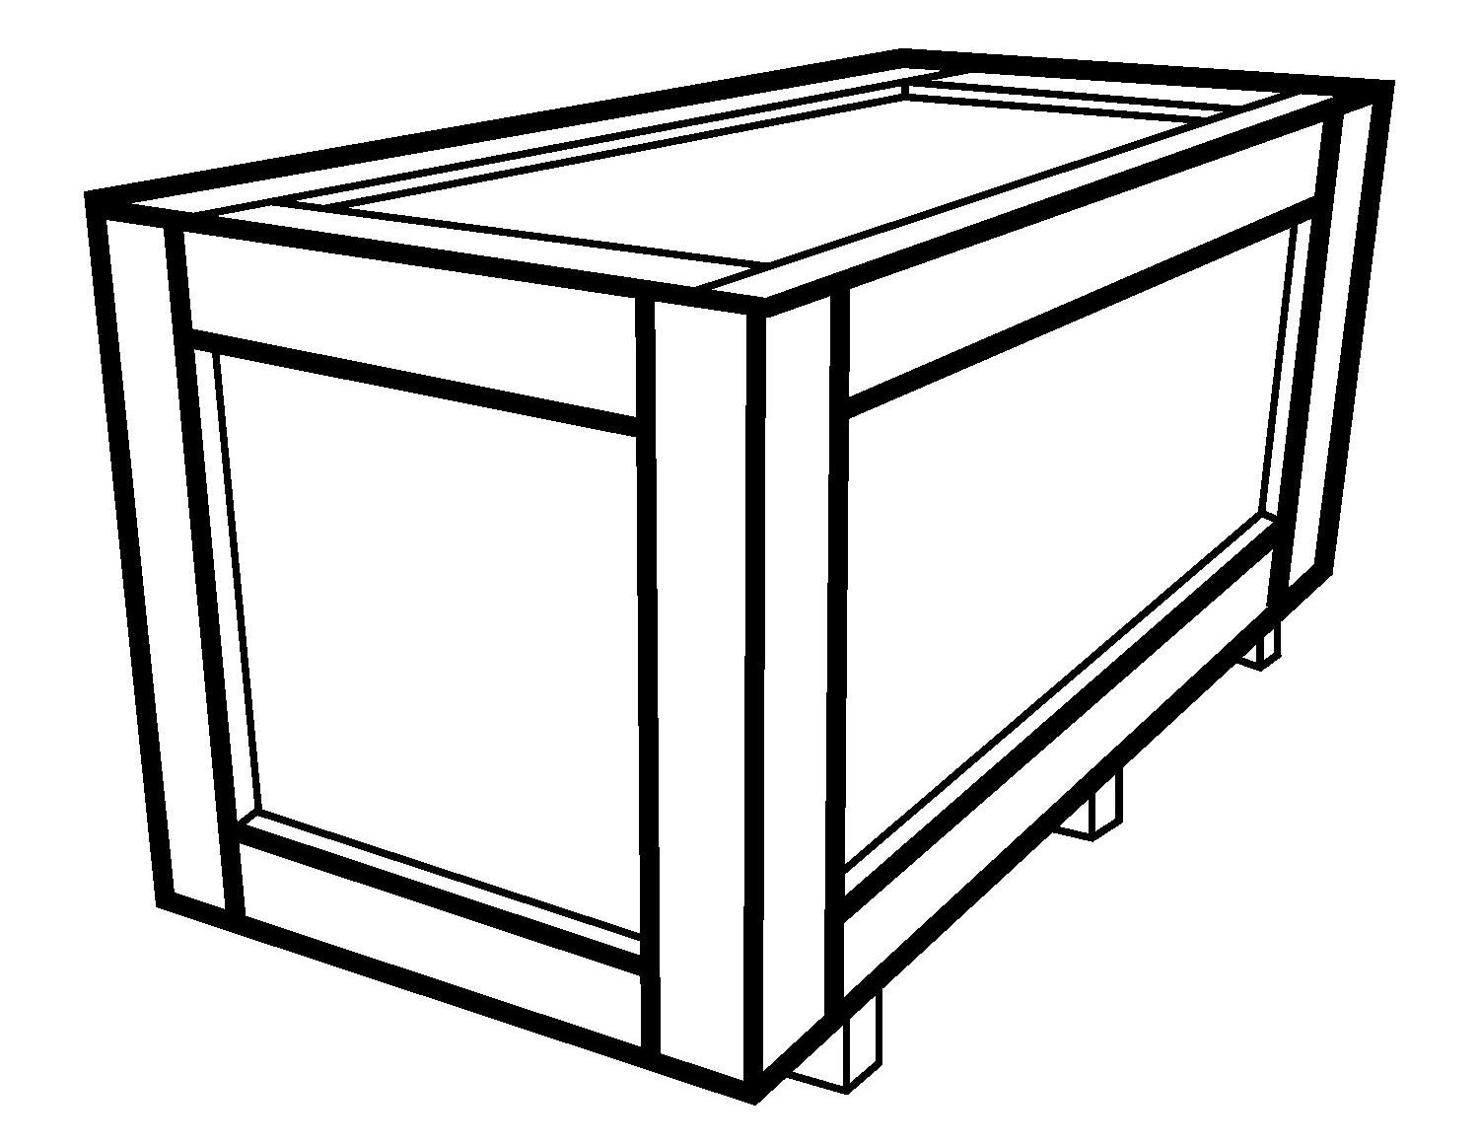


ISPM 15 Overview
What packaging does this apply to?
Any wood packaging made from solid wood.
Pallets, crates, dunnage.
What is not included?
Wood packaging material made entirely from thin wood (6 mm or less in thickness)
Wood packaging made wholly of processed wood material, E.g, plywood, particle board, oriented strand board or veneer wood components permanently attached to freight vehicles and containers.
Notes:
Brexit update: From 1 January 2021 all wood packaging material moving between the UK and the EU must meet ISPM15 international standards by undergoing heat treatment and marking.

Slide 5
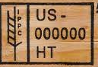
Wood Treatment
Heat treated wood (HT)
Only heat treated wood is acceptable at Cummins.
Please note: The use of Methyl Bromine treatment for wood is forbidden at Cummins.

Slide 6
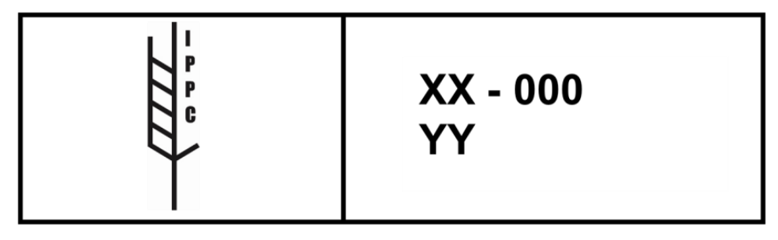
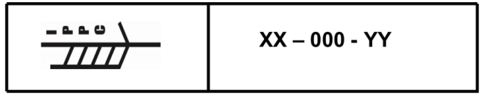
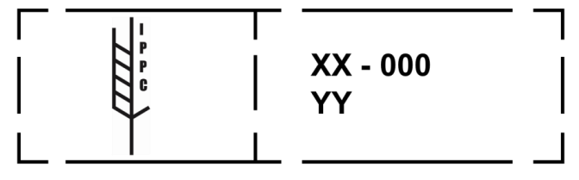
ISPM 15 Stamps
Stamp Layout Examples
Attributes of Stamp
IPPC Symbol to left
Country code (XX)
Producer/Treatment provider code (000)
Treatment code (YY)
Stamps must be:
Legible
Durable and non-transferable
Placed in at least two locations that are visible when the wood packaging is in use

Slide 7
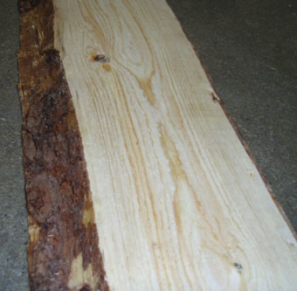

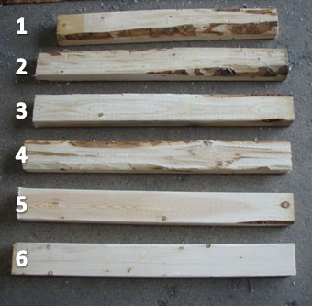
Debarked wood
x
This much bark is unaccepted
5&6 are accepted
6 is preferred
Debarked wood
Wood packaging material must be made of debarked wood.
Any number of visually separate and clearly distinct small pieces of bark may remain if they are:
  less than 3 cm/0.39 inch in width (regardless of the length)
  greater than 3 cm/0.39 inch in width, with the total surface area of an individual piece of bark less than 50 square cm/7.75 square inch.

Slide 8


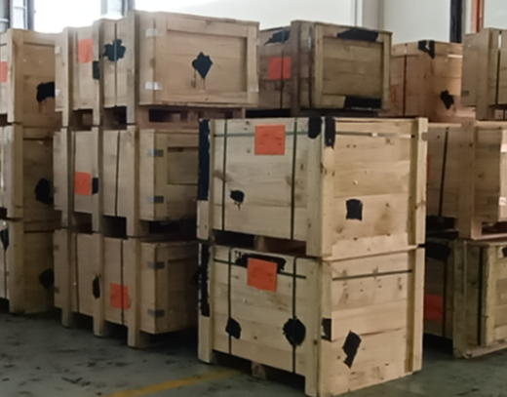
Pallet Reuse
Reuse of wood packaging material*
Wood packaging that is being reused and has not been repaired does not require re-treatment.
Repairing of wood packaging material
If more than 1/3 of the material is replaced, then the crate is considered
“remanufactured” and it must be retreated in its entirety, the old markings must be obliterated, and new markings placed on the crate for continued use as packaging.
Obliterated markings
*for shipping of product

Slide 9

Q&A
Test your knowledge

Slide 10
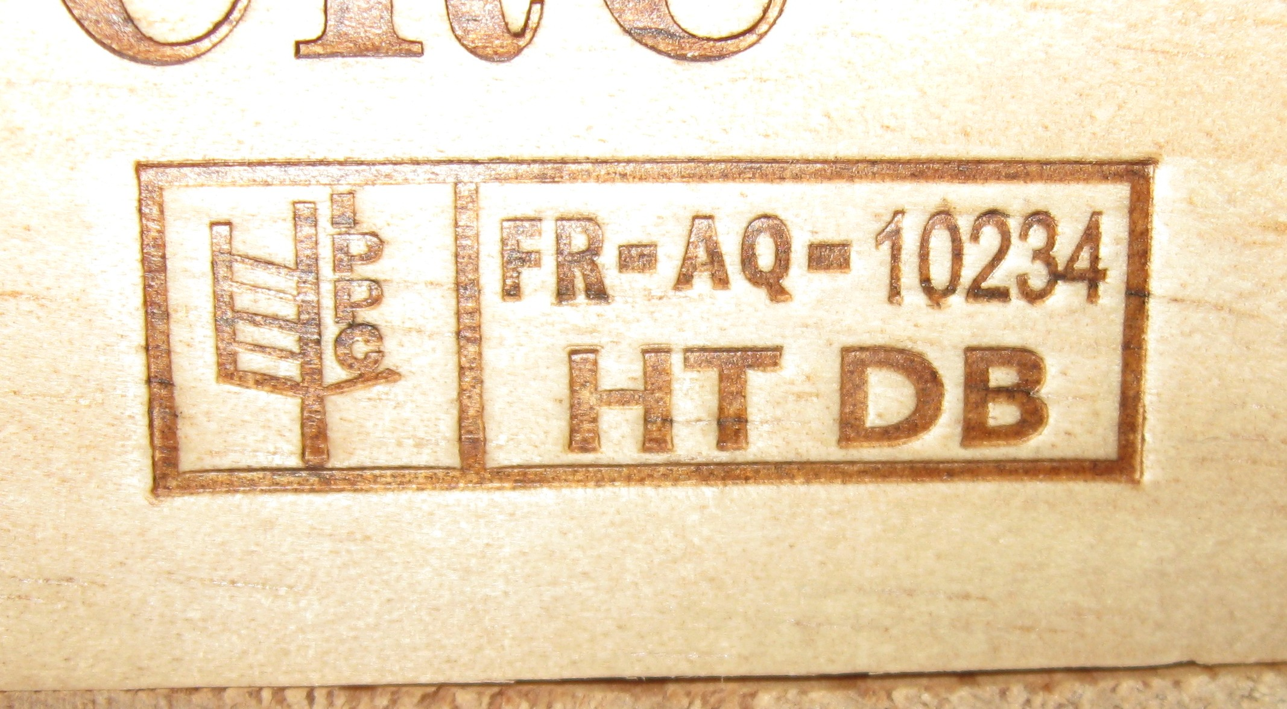
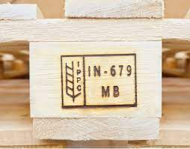
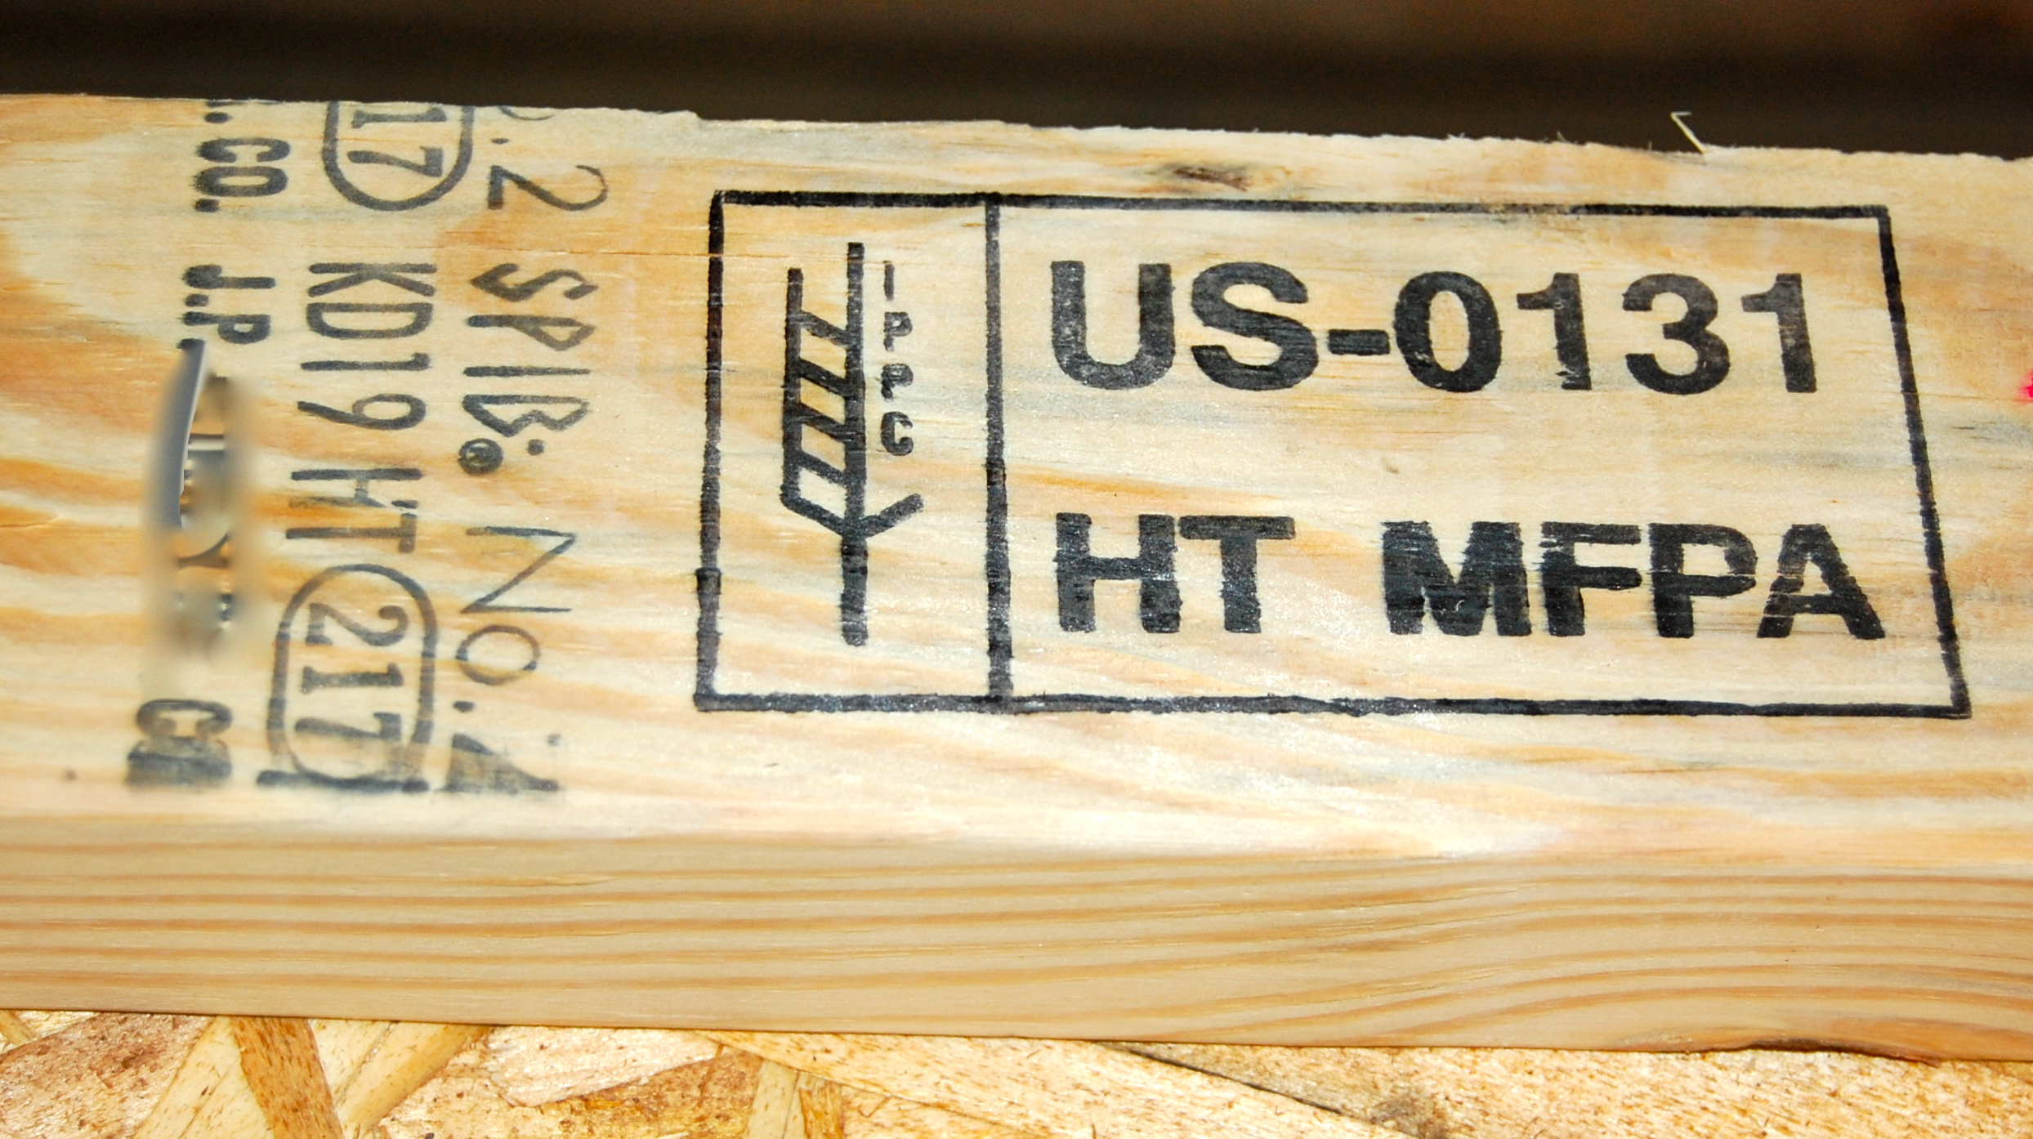
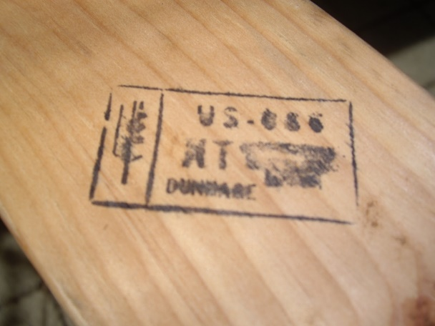
Q&A
Question 1
Which stamps are accepted at Cummins, and which are NOT?
1.
2.
3.
4.
Notes:
1. Correct
2. Correct stamp, however it is Methyl Bromine Treated
3. Correct
4. Incorrect, the stamp is illegible.

Slide 11
Q&A
Question 2
What wood treatment does Cummins use? What treatment is forbidden?
Dielectric treatment
Heat treatment
Methyl Bromine treatment
Sulphuryl Fluoride treatment
Notes:
Not used
Correct
This is forbidden at Cummins
Not used.

Slide 12

Q&A
Build your own ISPM 15 compliant pallet…
Notes:
Add why they are incorrect!

Slide 13
Q&A
Build your own ISPM 15 compliant pallet…
Select the wood treatment your pallet is going through…
Heat
Methyl Bromine
Sulphuryl Fluoride

Slide 14

Q&A
Build your own ISPM 15 compliant pallet…
Incorrect treatment, try again…
The use of Methyl Bromine treatment for wood is forbidden at Cummins.
Heat treatment is the only accepted wood treatment at Cummins

Slide 15
Q&A
Build your own ISPM 15 compliant pallet…
Select the wood treatment your pallet is going through…
Heat
Methyl Bromine
Sulphuryl Fluoride

Slide 16
Q&A
Build your own ISPM 15 compliant pallet…
Next, there is evidence of bark on the wood, what is the correct threshold of bark allowed on wood? Select the correct pallet…
Bark less than 5 cm/ 1.9 inch in width
Bark less than 3 cm/ 0.39 inch in width
Bark more than 3 cm/ 0.39 inch in width

Slide 17
Q&A
Build your own ISPM 15 compliant pallet…
Incorrect, try again…
Bark must not exceed 3 cm/ 0.39 inch in width

Slide 18
Q&A
Build your own ISPM 15 compliant pallet…
Next, there is evidence of bark on the wood, what is the correct threshold of bark allowed on wood? Select the correct pallet…
Bark less than 5 cm/ 1.9 inch in width
Bark less than 3 cm/ 0.39 inch in width
Bark more than 3 cm/ 0.39 inch in width

Slide 19
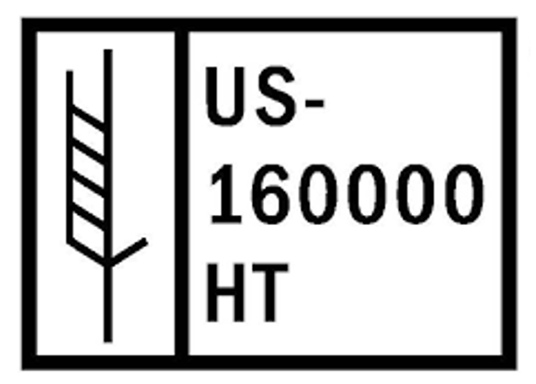


Q&A
Build your own ISPM 15 compliant pallet…
Now, select the correct stamp for your pallet…

Slide 20
Q&A
Build your own ISPM 15 compliant pallet…
Incorrect, try again…
Notes:
If you selected the first or the second stamps these are incorrect

Slide 21
Q&A
Build your own ISPM 15 compliant pallet…
Now, select the correct stamp for your pallet…
Notes:
The first stamp is incorrect as is IPPC lettering is missing from the symbol
The second stamp is also incorrect as it is a Methyl Bromine treated wood
The third stamp is correct

Slide 22
Q&A
Build your own ISPM 15 compliant pallet…
Where on the pallet will you put your stamps? Select the correct pallet.
Stamp placed in at least two locations that are visible when the wood packaging is in use
I don’t need to stamp. I know my pallet has been treated
1 stamp, on the underside of the pallet

Slide 23
Q&A
Build your own ISPM 15 compliant pallet…
Incorrect, try again…
Stamps shall be placed in at least two locations that are visible when the wood packaging is in use

Slide 24
Q&A
Build your own ISPM 15 compliant pallet…
Where on the pallet will you put your stamps? Select the correct pallet.
Stamp placed in at least two locations that are visible when the wood packaging is in use
I don’t need to stamp. I know my pallet has been treated
1 stamp, on the underside of the pallet

Slide 25
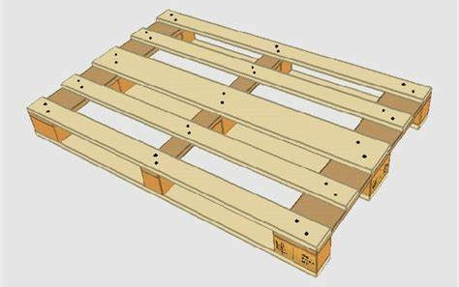
Q&A
Build your own ISPM 15 compliant pallet…
Heat treated, debarked, stamped wooden pallet.
Actual image of compliant pallet
ISPM 15 compliant pallet

Slide 26

Q&A
Key Takeaways
Heat treatment is the only accepted phytosanitary measure at Cummins.
Methyl Bromine is forbidden at Cummins.
Wood shall be debarked.
ISPM15 stamps are mandatory on all wood packaging.
Stamps must contain the certified IPPC symbol, Country code, Producer/Treatment provider code, and Treatment code.
Wood packaging material shall not be used if it doesn’t comply with the ISPM 15 Standard.
Key Takeaways…

Slide 27

Q&A
Key Takeaways…
Thank you for watching and completing the Cummins ISPM 15 training.

