Slide 1



Tips on Using IMDS
Committee Materials
Deb Reining
9/19/25
For use by Cummins suppliers

Slide 2
Introduction
Successful IMDS implementation requires careful user adherence to IMDS Handbooks and other guidance materials.
This presentation discusses selected tips on use of the IMDS Committee materials. If you see any inconsistency between these tips and IMDS Recommendations, follow the IMDS Recommendations.
If questions arise, please refer to your direct management for additional clarification.

Slide 3

Using IMDS Committee Materials
The IMDS Committee has published materials for most metals used in the automotive industry. These materials were created and maintained by the IMDS committees. There are also plating and coatings available through Committee materials.
The easiest way to find a committee metal is through the Unified Numbering System (UNS) code.
For plating and coating, generally a star search with the coating name is the easiest way to find them.
For use by Cummins suppliers

Slide 4
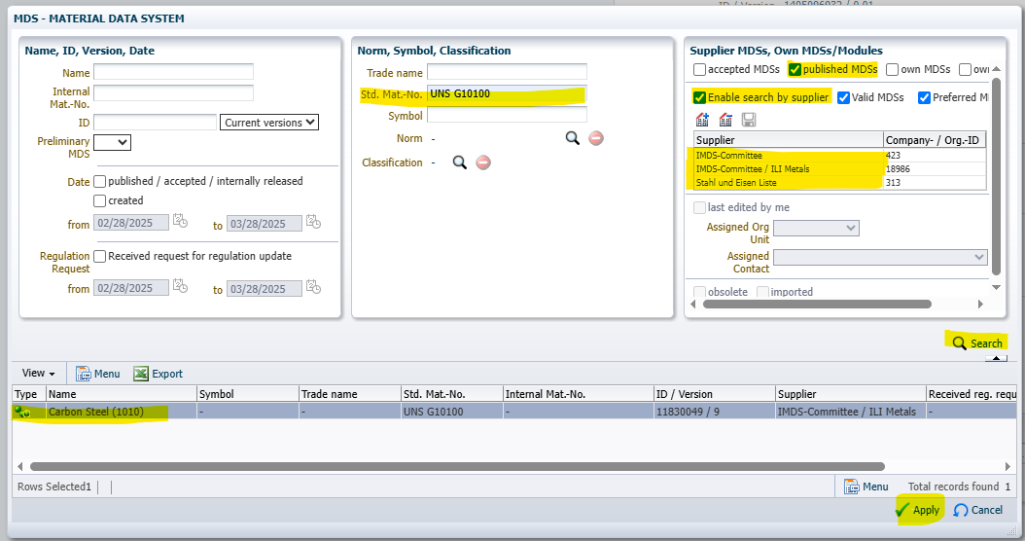
Committee Material Search
Type the UNS code into the Std. Mat. No. field, check the box for Published MDS, check box for Enable Search by Supplier. IMDS Committee supplier numbers will populate the fields. Press Search.
The committee material for the specified UNS code will populate the bottom section. In the case that there is more than one material associated with your UNS code, you can compare percentages.
For use by Cummins suppliers

Slide 5
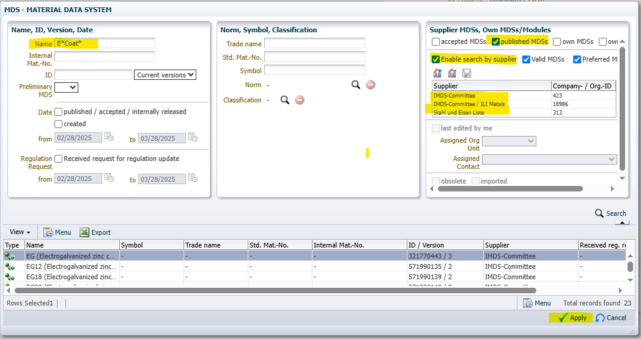
Using Committee Coatings
Check the box for Published MDS, check box for Enable Search by Supplier. IMDS Committee supplier numbers will populate the fields. Add the name of the coating or plating with**. Press search
Because of the ** you will get multiple records, review the records to determine the correct coating for your component.
For use by Cummins suppliers

Slide 6
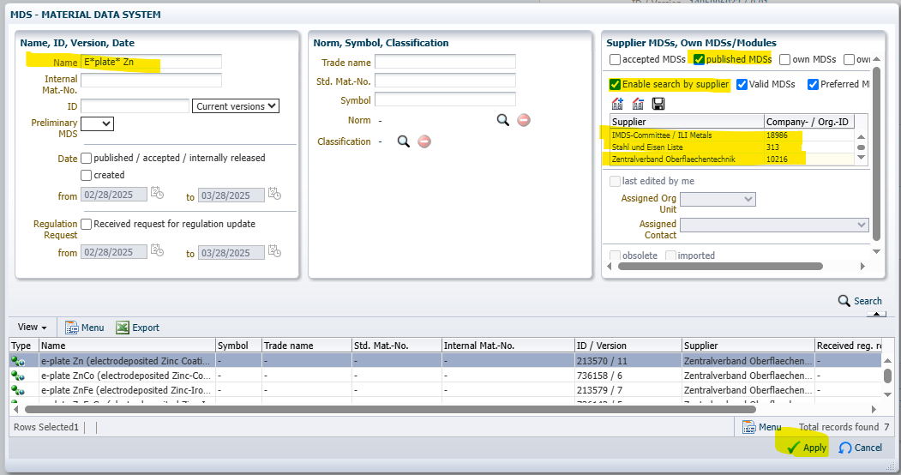
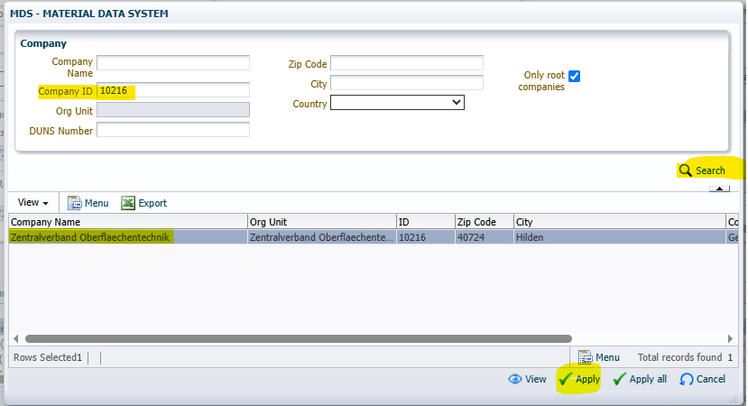
Using Committee Coatings
Zentralverband Oberflaechentechnik (ZO) will need to be added manually (ID 10216). Click the house+ symbol, in the pop-up window put 10216 in IMDS ID, click search, then apply.
Check the box for Published MDS, check box for Enable Search by Supplier. IMDS Committee will populate the fields.
For use by Cummins suppliers

Slide 7
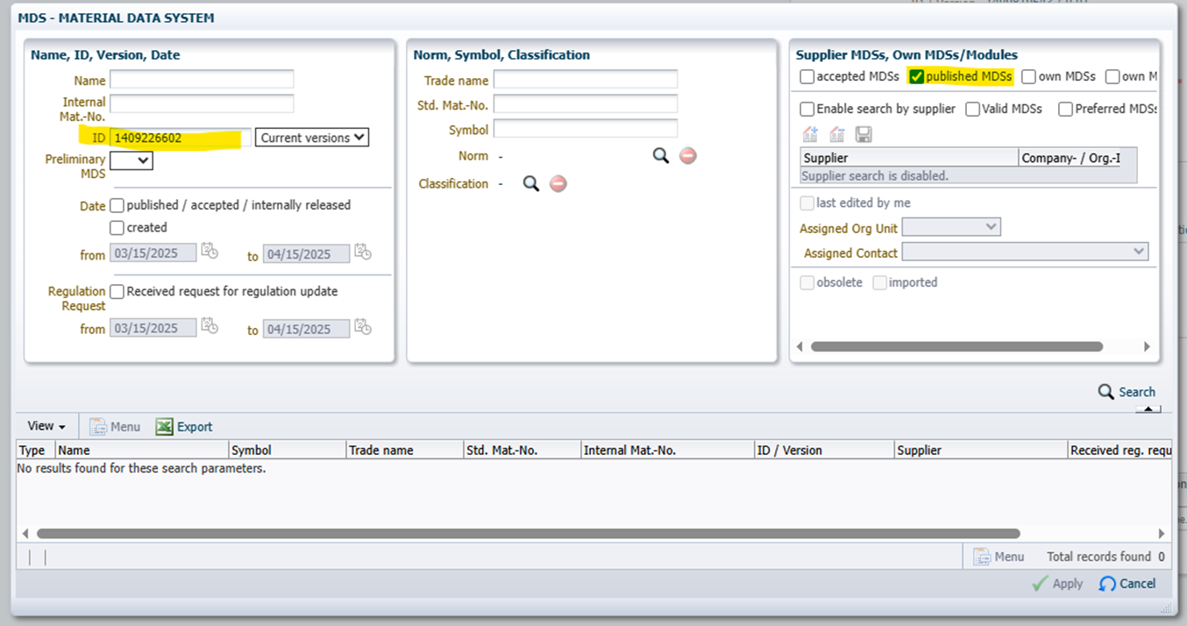
Finding Materials from IMDS ID
When the IMDS ID is available, you can find the MDS by putting the IMDS ID in the proper line item and checking the published materials box. Press Search and your MDS will appear.
For use by Cummins suppliers

Slide 8
For additional information and Frequently asked questions, please see the IMDS Public Pages at the link below:
https://public.mdsystem.com/en/web/imds-public-pages/faq
For use by Cummins suppliers

