Slide 1

Training: Restricted Substances Overview
2023
Public Use-Intended for Cummins Direct Suppliers

Slide 2
Restricted Substance Overview
03
Introduction
19
FMD Requirements / Tools
08
Key Regulations and Concepts
23
Conflict Minerals Tools
12
Cummins Expectations / Timing
25
Contacts and Resources
16
CES10903 Requirements
27
Key Regulations Details
Public Use – Intended for Cummins Direct Suppliers

Slide 3
Introduction
Public Use – Intended for Cummins Direct Suppliers

Slide 4
Introduction
To sell products globally, Cummins must be able to demonstrate product compliance to global regulations and customer requirements. Cummins can assess compliance to multiple regulations/requirements without having to resurvey the supply chain by reviewing supplier products Full Material Declarations (FMDs); and in some cases, additional specific information.
Purpose of this training is to:
Provide general information of key global regulations, so that suppliers can gain an understanding as to why Cummins is requesting product substance data.
Provide details regarding Cummins reporting tools and requirements.
***Unreported data leads to loss in market share as compliance cannot be verified.***
Public Use – Intended for Cummins Direct Suppliers

Slide 5

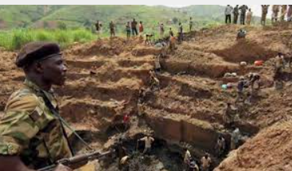
Introduction
Materials regulations (ex. ELV, RoHS, REACH, Conflict Minerals) and customer materials requirements aim to protect human health and the environment by limiting substances of concern (SoC); thus, promoting product recyclability, reducing human and environmental exposure to hazardous substances, and decreasing funding to areas of conflict in areas in and around the Democratic Republic of the Congo (DRC).
Public Use – Intended for Cummins Direct Suppliers

Slide 6
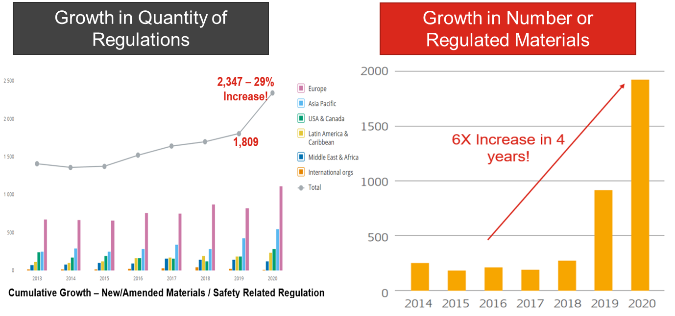
Introduction
The number of materials/substance related regulations are growing, as is Cummins' customer requests
Each year, new substances are added to both regulatory and customer restricted lists
Having the full material and substance breakdown of each product (Full Material Declarations, FMD) is essential for navigating the ever-evolving substance restrictions
Public Use – Intended for Cummins Direct Suppliers

Slide 7









Introduction
Lifecycle Requirements
(exists at all stages)
Mining & Smelting
Customer Requirements
OEM Certification
Handling & Disposal
Components
OECD & UN Guidelines
Annual Supplier Surveying
SEC & Customer Reporting
Thousands of supplied products
Data needed for all products
Evaluation of exemptions / exclusions
Hundreds of Customer requests / Month
Future ELV Expansion from car to heavy truck
Each country has its own requirements
Hundreds of Part level certs
Thousands of Compliance Documents & tech files
Batteries
Switchgear & Gensets
Filters
Coolants / Chemicals
Public Use – Intended for Cummins Direct Suppliers

Slide 8
Key Regulations and Concepts
Public Use – Intended for Cummins Direct Suppliers

Slide 9




Key Regulations Lists and Concepts
Action: Click the underlined links for regulation details
North America:
Conflict Minerals
California Prop 65
TSCA
Latin America:
Brazil RoHS
Europe:
REACH
EU RoHS
ELV
Battery Directive
WEEE
Ukraine RoHS
Asia:
China RoHS
GCC RoHS
Public Use – Intended for Cummins Direct Suppliers

Slide 10
Key Regulations Lists and Concepts
Regulatory substance thresholds can be at the homogenous material level or lowest component/article level.
Some regulations only require substance disclosure; having that substance doesn’t necessarily make the product non-compliant.
Regulatory requirements are not static. Substances get added/removed, thresholds can change, and exemptions can expire.
Common Theme: Know What’s In Your Product, Where the Material Came From & Where You Sold It

Slide 11
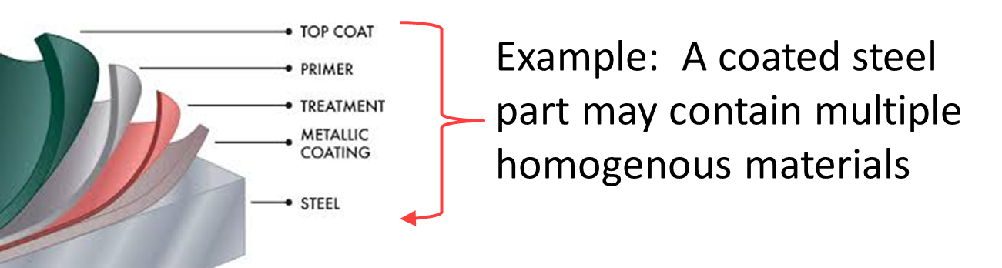
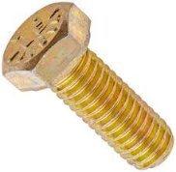
Key Regulation Lists and Concepts
Homogenous Material
  A material with a uniform composition throughout
  A material that consists of a combination of materials, that cannot be disjointed or separated into different materials by mechanical actions such as unscrewing, cutting, crushing, grinding or abrasive processes (ex: pigmented plastics).
  For substance thresholds at the homogenous level (ex: ELV/RoHS), EACH material must be compliant for product compliance.
% of substance in a homogenous material
Concentration to compare against threshold
=
Substance % at Lowest Article Level
  The substance threshold (0.1%) for REACH SVHCs is based on the % of the substance at lowest component level
  To determine if the SVHC is over 0.1%, calculate the total weight of the substance in the lowest component and divide it by the lowest component weight.
Total Weight of substance
*Concentration at lowest article level(ex: REACH SVHC)
=
Weight of article

Slide 12
Cummins Expectations and Timing
Public Use – Intended for Cummins Direct Suppliers

Slide 13
Cummins Expectations and Timing
At the very least, Cummins' suppliers must comply with all applicable environmental laws and regulations in areas where they do business, adhere to Cummins' Prohibited Substances standard CES 10903, and provide required documentation. Additionally, suppliers should prioritize their actions and partner with Cummins in the following four categories:
Mitigating Risk (Water and energy)
Supporting ISO 14001
Reducing Environmental Footprint
(Packaging and transportation guidelines)
Creating Opportunities (Sharing ideas on processes that impact Cummins)
13

Slide 14
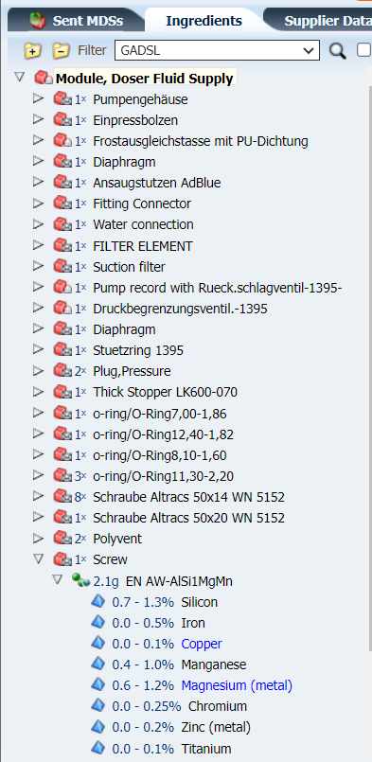
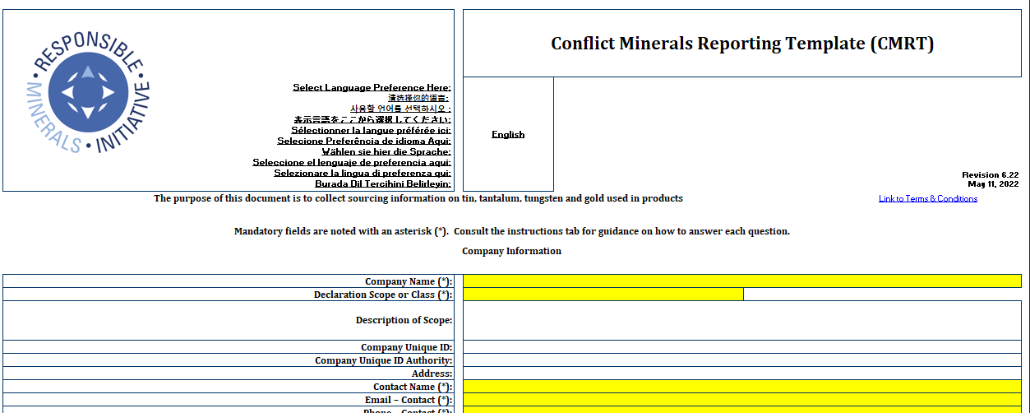
Cummins Expectations and Timing
Suppliers are required to provide full material declarations (FMD) and/or Conflict Minerals data within 45 days of Cummins request.
FMD is required as part of PPAP and/or the new product development process for All products via IMDS or CDX. Providing FMDs avoids having to resurvey the supply chain each time a new substance is added to regulatory or customer lists and is used to demonstrate compliance to multiple regulations.
If we don't have the information, we can't provide compliance information to customers and regulatory authorities, and our market access may be limited.
Example of FMD from IMDS/CDX (left)
Example of CMRT (right)
Public Use – Intended for Cummins Direct Suppliers

Slide 15
Cummins Expectations and Timing
WHY FULL MATERIALS DISCLOSURE:
Full Materials Disclosure allows us to meet regulatory obligations now and in the future in the most efficient way. FMD provides us will all the necessary information and will NOT require repetitive actions with the supply base every time there is a change in regulations. FMD reduces the supply chain data collection and compliance costs.
  FMD vs. Partial Declarations
Partial material declarations prevent us from fulfilling global regulatory obligations, customer expectations and put our market access in jeopardy.
Variability in data collection tools and levels of material declaration has created large amounts of redundant activities within the supply chain.
Partial declarations result in incremental and repetitive data collection activities that increase the cost of our products. This inconsistent approach is inefficient and unsustainable.
OUR ASK FROM YOU:
Provide us with Full Material Disclosure to:
  Support compliance evaluation
  Reduce supply chain costs
  Maintain our market share
  Increase the life cycle of the products
Public Use – Intended for Cummins Direct Suppliers

Slide 16
CES 10903 Requirements
Public Use – Intended for Cummins Direct Suppliers

Slide 17
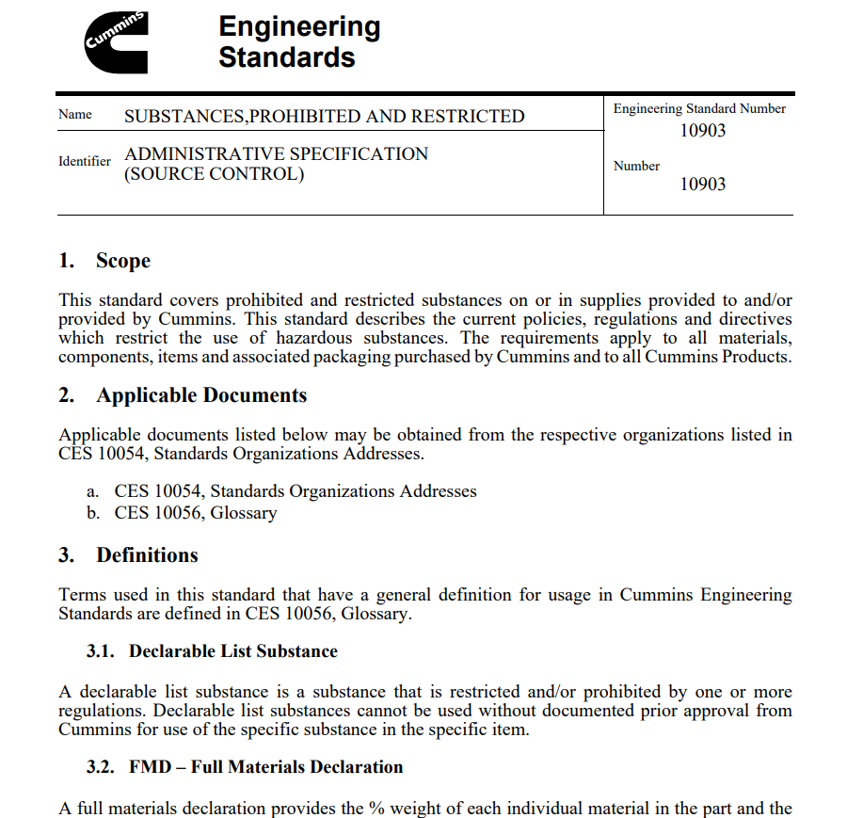
CES 10903 Requirements
Cummins Engineering Standard (CES) 10903
Details Cummins specific prohibited and restricted substances
Must be followed by all direct suppliers
Not following CES 10903 may result in regulatory non-compliance and failure to meet our customer’s requirements.
Public Use – Intended for Cummins Direct Suppliers

Slide 18
CES 10903 Requirements
Cummins requires its suppliers to comply with the CES 10903 standard which requires the disclosure of all substances present in materials and components where the substance is present at or above the defined threshold value within each homogenous material.
Prohibited Substances:
Must not be present in any items as an intentional addition and is not permitted to be present in any items as a residual above a threshold value. Click here to see a full list of prohibited substances.
Declarable List Substances:
A substance that is restricted or prohibited by one or more regulations. Declarable list substances cannot be used without documented prior approval from Cummins for the specific use in the specified item. Click here to view a list of the Declarable Substances List.
It is the responsibility of the supplier to verify that the substances listed in CES 10903 are not in any products or materials supplied to Cummins per the referenced threshold.
Public Use – Intended for Cummins Direct Suppliers

Slide 19
FMD Requirements and Tools
Public Use – Intended for Cummins Direct Suppliers

Slide 20

FMD Requirements and Tools
CDX is the preferred FMD tool for off-highway. IMDS must be used for on-highway FMD submissions.
CDX-Compliance Data Exchange
CDX is used to obtain FMD for non-automotive parts. It is to compile a comprehensible and coherent representation of product's SoC content. CDX helps to understand material compliance status by analysis of the whole asset and to manage the suppliers' reporting requirements.
*CDX is the industry preferred tool for non-automotive*
IMDS-International Materials Data
Used to support automotive manufacturers. IMDS can be used for automotive applications only*.
The IMDS Steering Committee takes the IMDS Terms of Use (ToU) seriously.
* some OEMS have DXC approval for IMDS data collection of non-automotive applications
Public Use – Intended for Cummins Direct Suppliers

Slide 21
FMD Requirements and Tools
Anthesis spreadsheet or BoM Check may be used for off-highway FMD submissions, with permission.
Anthesis
Excel spreadsheet downloaded from Cummins website.
This tool can be used to provide product compliance data for non-automotive applications products.
Multiple part numbers can be included in a single spreadsheet.
BOMCheck
Online resource for sharing product compliance data.
This tool is used to collect non-automotive application products.
Supplier data for a single part number would only need to be entered once but can be shared with multiple customers.
Public Use – Intended for Cummins Direct Suppliers

Slide 22
FMD Requirements and Tools
  Data requested as part of PPAP, new product development, or upon request for ALL products
  Supplier responses must be received within 45 days
  FMD submissions must meet IMDS Recommendation 001 and represent the product in its final state (without packaging or process materials)
  IMDS/CDX Recipient Data must include the Cummins PN and Cummins Supplier Code (ex: SIM ID, S360ID, Vendor Code, or Internal Supplier ID as referenced in the MDS Request e-mail notification)
  IMDS - www.mdsystem.com – Directed to 3664
  CDX – www.cdxsystem.com – Directed to 13170
  Anthesis or BoM Check – may be used with permission
  Confirmation of Acceptance must be included with PPAP documentation
  IMDS/CDX ID (or “Anthesis”, “BoMCheck”, along with the name of the Cummins approver for using the alternate method) must be entered on the PPAP Warrant
Public Use – Intended for Cummins Direct Suppliers

Slide 23
Conflict Minerals Tools
Public Use – Intended for Cummins Direct Suppliers

Slide 24
Conflict Minerals Tools
Conflict Minerals
  Data requested every June, targeted campaign (typically to suppliers of products likely to contain Mica, Cobalt, 3TG; Tin, Tantalum, Tungsten, and Gold)
  Data submission via Excel and resources may be found on the RMI Website or via IPoint Software
  Excel tools – Directed to conflictminerals.reporting@cummins.com
  IPoint Software Submission – Directed to 2649
Public Use – Intended for Cummins Direct Suppliers

Slide 25
Contact Information
Cummins Supplier Portal
General Contacts for FMD (IMDS-CDX)
supplier.compliance@cummins.com
Conflict Materials
conflictminerals.reporting@cummins.com
Cummins Green Supply Chain
getenvolved@cummins.com
Public Use – Intended for Cummins Direct Suppliers

Slide 26



Slide 27
Key Regulations Details

Slide 28
EU ELV
What is EU ELV?
  European Union’s (EU) End-of-Life Vehicle (ELV) directive restricts certain substances in automobiles goal of reducing the environmental impact at the end of the vehicle's useful life.
  It originally entered into force September 18, 2000 (2000/53/EC) and set the stage for other product compliance regulations such as EU RoHS and EU REACH.
  ELV is applicable to automobile manufacturers that manufacture or import into the EU. Although, most all global manufacturers have adopted the ELV requirements.
  ELV applies to passenger cars (M1) and light commercial vehicles (N1). However, the EU is evaluating a proposed expansion to include motorcycles and larger vehicles.
  The ELV directive may be found here and current exemptions may be found here.
  The automotive manufactures have agreed to use the IMDS (www.mdsystem.com) as their data collection tool to demonstrate ELV compliance for EU Type Approvals.
  All suppliers in the OEM supply chain must provide FMD in IMDS.
  The Cummins products, used in automobiles, must comply with the ELV to meet their customer’s requirements.

Slide 29
EU ELV
ELV Substance Restrictions (Examples of Homogenous Materials)
  Substances restricted (Max tolerated in a homogenous material):
    Lead (0.1%) (solders, termination coating, metals, paints, pigment, PVC stabilizer)
    Mercury (0.1%) (fluorescent lamps, batteries, sensors, relays)
    Cadmium (0.01%) (coatings, solders, semiconductors, contacts, PVC stabilizers, pigments)
    Hexavalent chromium (0.1%) (coatings to prevent corrosion on zinc or aluminum or in paints)
  Some exemptions exists, depending on application, and some have expiration dates.

Slide 30
EU RoHS
What is EU RoHS?
  EU RoHS is the European Union’s Restriction on Hazardous Substances.
  RoHS is a European Union (EU) legislation that restricts certain substances in electrical and electronic equipment with the goal of reducing the environmental impact of such equipment.
  It originally entered into force July 1, 2006 (2002/95/EC) and was later revised June 8, 2011 (2011/65/EU) and entered into force July 3, 2013.
  The latest version of RoHS may be found here.
  Countries beyond the EU (ex: China, Korea, India, Ukraine, GCC Member States) have RoHS-like legislation with varying restrictions, exemptions, and scope.
  Many Cummins products are considered electrical and electronic equipment.
  Suppliers must provide FMD for Cummins to evaluate RoHS Compliance.

Slide 31
EU RoHS
RoHS Substance Restrictions (Examples of Homogenous Materials)
  Substances restricted (Max tolerated in a homogenous material):
    Lead (0.1%) (solders, termination coating, metals, paints, pigment, PVC stabilizer)
    Mercury (0.1%) (fluorescent lamps, batteries, sensors, relays)
    Cadmium (0.01%) (coatings, solders, semiconductors, contacts, PVC stabilizers, pigments)
    Hexavalent chromium (0.1%) (coatings to prevent corrosion on zinc or aluminum or in paints)
    Polybrominated biphenyls (PBB) (0.1%) (flame retardant in certain plastics)
    Polybrominated diphenyl ethers (PBDE) (0.1%) (flame retardant in certain plastics)
    Bis (2-ethylhexyl) phthalate (DEHP) (0.1%) (Plasticizers in certain plastics and cables)
    Butyl benzyl phthalate (BBP) (0.1%) (Plasticizers in certain plastics and cables)
    Dibuytl phthalate (DBP) (0.1%) (Plasticizers in certain plastics and cables)
    Diisobutyl phthalate (DIBP) (0.1%) (Plasticizers in certain plastics and cables)
  Some exemptions exists, depending on application, and some have expiration dates.

Slide 32
EU REACH
What is EU REACH?
  European Union’s Registration, Evaluation, Authorization and Restriction of Chemicals
  Designed to protect human health and the environment. It entered into force in June 2007.
  Aims to monitor and restrict the movement of hazardous chemicals through the EU, including substances in preparation form (materials) and incorporated into articles
  It replaces 40 years of old EU chemical legislations by compiling them into one
  It contains 849 pages of text, plus tens of thousands of pages of technical guidance.
  Applies to EU legal entities but many requirements flow down the supply chain.
  Requirements apply to all industries and vary depending on the product (substance, preparation/material, or article)

Slide 33
EU REACH
Registration – A substance must be registered with the European Chemicals Agency (ECHA), if the substance is imported, manufactured or intentionally released from an article > 1 ton per year by itself or as part of a preparation (mixture/material)
Authorization – Banned substances, will need special authorization in order to continue to be allowed used in the EU.
Potential banned substances are taken from the Candidate List (aka: Substances of Very High Concern, SVHC) list.
Companies manufacturing or importing SVHCs in the EU, in greater than 0.1% at the lowest component level, may have Notification (to ECHA) and/or Communication (to Customers) requirements depending on the amount of the SVHC. Supply chain data is needed to evaluate REACH obligations.

Slide 34
EU REACH
SVHCs Details
  SVHCs that are added to the Candidate List are candidate for elimination from the EU market.
  The SVHCs on the Candidate List are updated twice per year.
  The current list of SVHCs / SVHC substance groups may be found here.
  It is critical that suppliers provide Cummins detailed information regarding the amount of any SVHCs in their products. This information is needed to determine Cummins’ or Cummins’ customers’ Communication, Notification obligations, and Substances of Concern In Products (SCIP) database entries as part of the EU Waste Framework Directive.
  Suppliers must provide FMD so that the supply chain does not need to be re-surveyed every time a new SVHC is added to the Candidate List.

Slide 35
Conflict Minerals
Reporting is required per Section 1502 of the Security and Exchange Commission (SEC) Dodd Frank Act
As a SEC Reporting requirement, it applies to publicly traded companies and ensures that each company is meeting the international responsible sourcing standards, set by the Organization for Economic Co-operation and Development (OECD)
Enacted due to concerns that the financial gain of mining in certain regions supports conflict in the DRC (Democratic Republic of Congo) region of Africa.
Requires reporting of the smelters used for the 3TG (tin, tantalum, tungsten, and gold and their compounds) that are “necessary to the functionality or production” of a product manufactured or contracted to be manufactured by the company.
The Extended Responsible Mineral Initiative, separate from the Dodd Frank Act, requires similar data for mica and cobalt.
Suppliers must respond to Cummins 3TG, mica, and cobalt requests using the EMRT, CMRT, PRT Excel templates or via electronic response using the Ipoint software.

Slide 36
US California Prop 65
Proposition 65 requires businesses to notify Californians about significant amounts of chemicals in the products they purchase, in their homes or workplaces, or that are released into the environment.
Notification is typically done through labeling, package inserts, or signage; with specific language as directed by the requirement.
This regulation applies to companies based out of California and any company that does business within the state.
Proposition 65 also prohibits companies that do business within California from knowingly discharging listed chemicals into sources of drinking water.
The California state government updates and maintains a list of applicable chemicals and No Significant Risk Levels (NSRLs)—if you have a chemical in your product but the amount is under the NSRL, you don’t have to publish a notification
In order for Cummins to determine their Prop 65 obligations, FMD from suppliers is required. FMD can be submitted via IMDS or CDX, depending on the end use of the product.

Slide 37
US TSCA
What is US TSCA?
  The Toxic Substances Control Act of 1976, with recent updates, provides the EPA with authority to require reporting, record-keeping and testing requirements, and restrictions relating to chemical substances and/or mixtures.
  It facilitates the EPA’s access in order regulate new commercial chemicals before they enter the market
  It supports the creation of new regulations for chemicals already existing in 1976 that posed an "unreasonable risk to health or to the environment", as for example PCBs, lead, mercury and radon,
  It regulate chemicals' distribution and use.
  Requires Chemical Inventory and Chemical Data Reporting
Cummins must review their product chemicals to determine their applicability to TSCA and TSCA reporting requirements. Supplier FMD data and SDSs (Safety Data Sheets) are necessary to complete that process.

Slide 38
GHS and US HCS
The Globally Harmonized System (GHS) of Classification and Labelling of Chemicals is a universal system for chemical labelling for safety, environmental, and industrial reasons.
The GHS System clarifies three aspects of chemical reporting—classification, labelling, and Safety Data Sheets (SDSs). Business sectors have adopted GHS guidelines, including transportation, workplaces (industrial and non-industrial), consumer, and pesticides.
Hazard classes are divided into 3 areas—Physical Hazards (17 classes), Health Hazards (10 classes), and Environmental Hazards (2 classes).
GHS classification determines the hazard class and category of a chemical, which in turn determines the labelling that is required. GHS labels include product identifiers, supplier identification, signal words, a hazard pictogram, hazard statements, and precautionary statements.
The US implemented the GHS global standards in 2012 through the Hazard Communication Standard (HCS), issued by OSHA (Occupational Safety and Health Administration). Beginning June 1st, 2015, all hazardous substances and chemicals had to be labelled correctly according to the GHS standards.
Suppliers must ensure that their SDSs are in accordance with GHS standards. Suppliers must include SDSs with initial shipment. Revised SDSs must be included with the shipment following its revision. Suppliers must respond timely to 3E and Cummins SDS collection inquiries

Slide 39
EU Battery Directive
What is the EU Battery Directive?
  The EU Battery Directive (COM(2020) 798) aims to contribute to the protection, preservation and improvement of the quality of the environment by minimizing the negative impact of batteries and accumulators.
  The EU Battery Directive harmonizes requirements for placing of batteries on the market.
Cummins requires battery supplier support to meet the requirements. Although some data can be obtained via FMD; such as component weight, additional information will be needed;
  Recycled Content (if not already included in the FMD)
  Presence and Origin of Critical Materials
  Supplier Code of Conduct referencing their supply chain stewardship program

