Slide 1

Creating in IMDS
Deb Reining
June 24, 2025
For Use by Cummins suppliers

Slide 2
Agenda
2 MINUTES
MDS Creation
5 MINUTES
Adding Committee Materials
2 MINUTES
Submitting to a Customer
For Use by Cummins suppliers

Slide 3
Introduction
Successful IMDS implementation requires careful user adherence to IMDS Handbooks and other guidance materials.
This presentation discusses selected tips on creating data sheets in the IMDS system. If you see any inconsistency between these tips and IMDS Recommendations, follow the IMDS Recommendations.
If questions arise, please refer to your direct management for additional clarification.
For use by Cummins suppliers

Slide 4
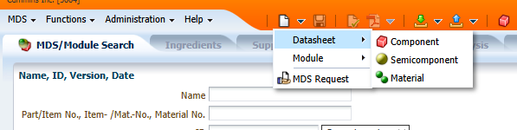
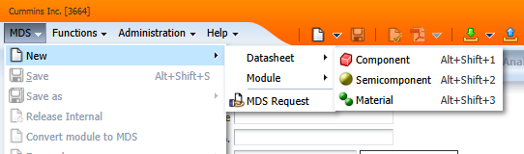
MDS Creation
To create a new MDS in the IMDS system, go to the blank paper short cut click Datasheet, and chose your type.
If you prefer, you can use the MDS dropdown menu, New, Datasheet, and chose your type
For Use by Cummins suppliers

Slide 5
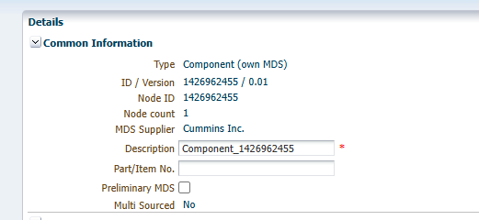
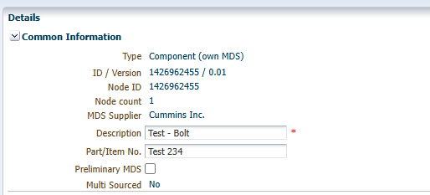
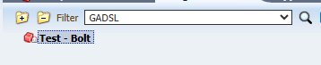
MDS Creation
Add Part number and Part name to the Common Information section on right side of the screen. Once the name is filled in it will populate in the tree on the left side of the screen. When building an MDS, save often so you do not lose any work.
For Use by Cummins suppliers

Slide 6
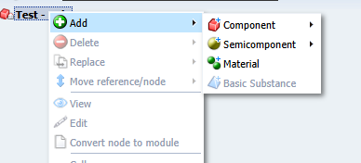
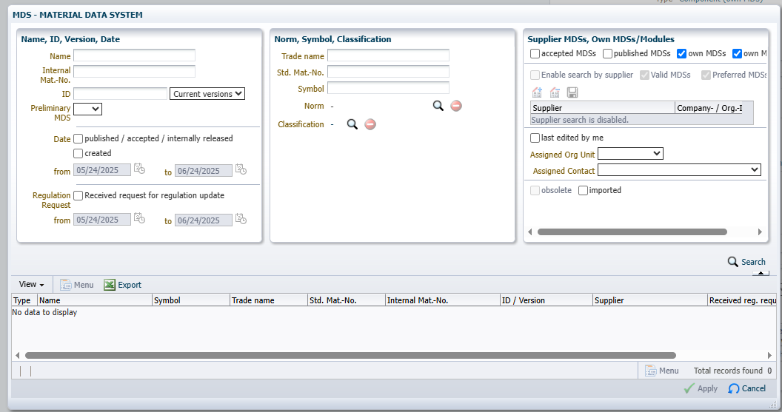
Adding Material
Whenever possible use IMDS Committee material when building your components. This will save time and stress. To find Committee materials, right click, Add, Material. The pop-up box below will appear.
For Use by Cummins suppliers

Slide 7
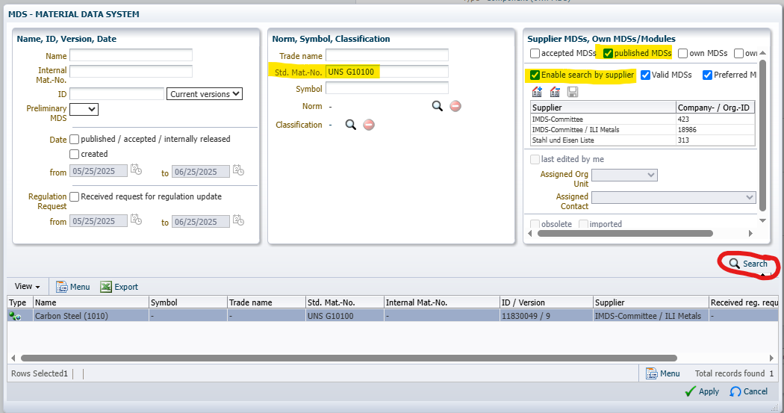
Adding Material
The fastest way we have found to find a IMDS Committee material is to use the Unified Numbering System (UNS) code. You can use any search engine to find these codes. To add Committee material to your part set up the search window this way then press the Search button.
For Use by Cummins suppliers

Slide 8
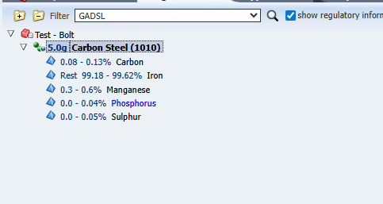
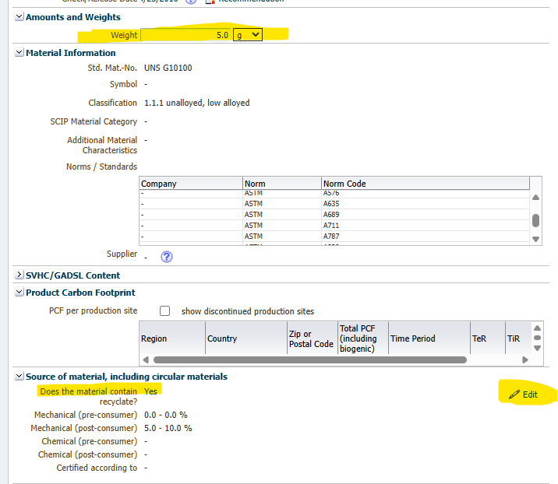
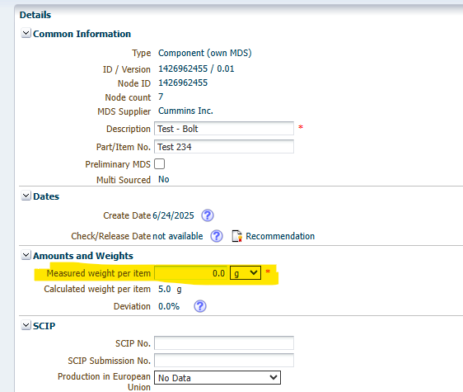
Adding Material
Once the material is added to your component, add the material weight and recycled content of your part to the right side of the screen. Be sure to add the weight to the Component level part also, you will get an error if this is not completed.
For Use by Cummins suppliers

Slide 9

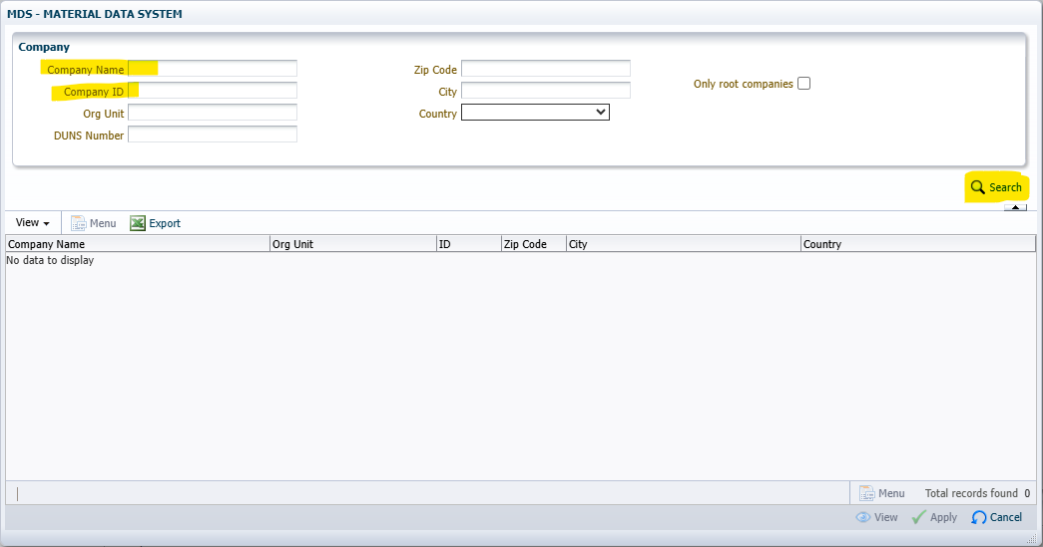


Submitting to a Customer
Click on the House with the plus. In the pop-up window, add the company name or IMDS ID, add the company name or IMDS ID, then click Search. Confirm the correct company appears, then click Apply
The company name will populate the top left corner.
Cummins prefers suppliers to use the “Propose” button
The submission will be reviewed in order of receipt, accepted or rejected. Due to the volume of supplier submissions, it may take some time to get a disposition.
For Use by Cummins suppliers

Slide 10
For additional information, please use these links:
https://public.mdsystem.com/en/web/imds-public-pages/tutorials
https://supplier.cummins.com/materials-disclosure-requirements-and-guide
For Use by Cummins suppliers

