Slide 1


Common MDS Rejections Supplier FAQ
(A Practical Guide to Accurate MDS)
Priscila Rodrigues De Oliveira
July 11, 2025
For use by Cummins suppliers

Slide 2
Introduction
Successful IMDS implementation requires careful user adherence to IMDS Handbooks and other guidance materials.
This presentation discusses Common MDS Rejections and Supplier FAQ. If you see any inconsistency between these tips and IMDS Recommendations, follow the IMDS Recommendations.
If questions arise, please refer to your direct management for additional clarification.
For use by Cummins suppliers

Slide 3
Purpose
Understand the most frequently asked questions related to product compliance and material data submissions.
Apply best practices when using IMDS or CDX to ensure accurate and complete Material Data Sheets (MDS).
Avoid common errors that lead to submission rejections and delays.
Align with Cummins policies, including CES 10903 and the Product Compliance Manual.
Strengthen collaboration between Cummins and its supplier network through clear, consistent compliance practices.
For use by Cummins suppliers

Slide 4
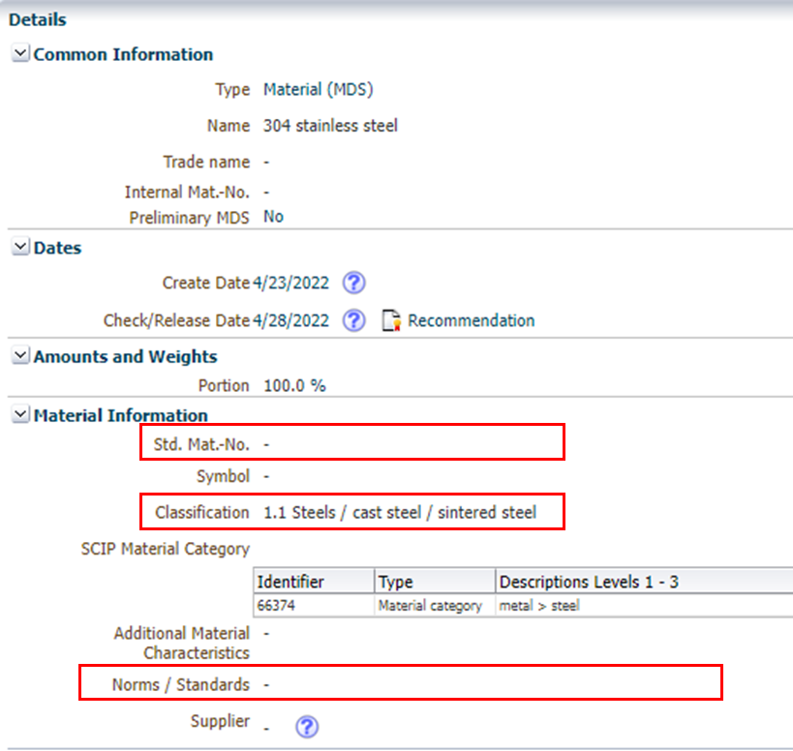
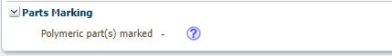
Common MDS Rejection Reasons
1) Missing Norms/Standards:
For materials over 5g in Classification 1x–4x, add Norms and Standards or use MDS Committee materials.
(Ref: IMDS Rec 001)
2) Incorrect material classification:
Classification 1.1 is only for sintered steel.
Other metals must be classified as 1.1.1 (unalloyed/low alloyed) or 1.1.2 (highly alloyed).
(Ref: IMDS Rec 001)
3) Missing Polymeric part marking:
Only “YES” or “NA” are acceptable answers to this question. No other responses will be accepted.
For use by Cummins suppliers

Slide 5
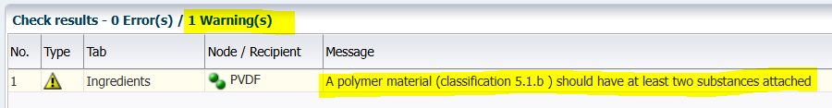
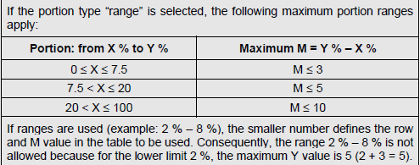
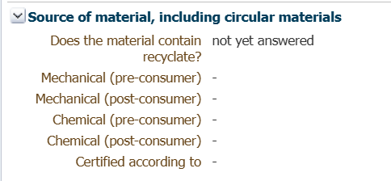
Common MDS Rejection Reasons
4) Polymer material (classification 5.x):
Should have at least two substances attached to it.
(Ref: IMDS Rec 001 Guideline 4.4.1.a)
5) Range of portion:
When using the “range” portion type, do not exceed the allowed maximum percentage limits.
(Ref: IMDS Rec 001 Rule 4.5.4.B)
6) Recyclate Info (5.x Materials):
Must answer YES or NO to the recyclate question. If YES, complete the recyclate screen. Share info if available.
For use by Cummins suppliers

Slide 6
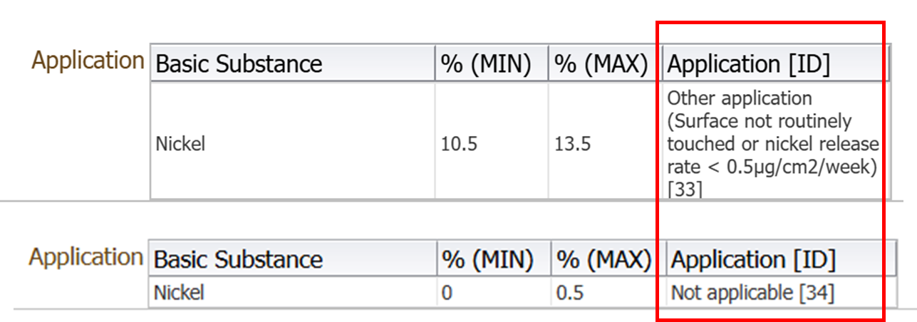
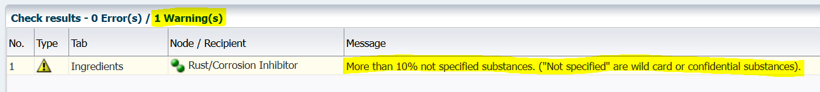
Common MDS Rejection Reasons
7) Nickel application codes:
Use Application Code 32 only for frequently touched parts (e.g., knobs, key fobs).
All other nickel-containing materials must use Code 33 or 34.
8) Cured material reporting:
Only report materials in their final, cured form as used in the vehicle. Exclude processing chemicals like solvents, water, oxygen or other liquids unless they remain in the finished part.
9) Use of Jokers/Wildcards:
Confidential substances, including jokers/wildcards, must not exceed 10% of a material.
Avoid using “Rest” with a wildcard, as it may cause the total to exceed the 10% limit.
Wildcards must not be used to hide GADSL-declarable, prohibited, SVHC, or application code-required substances.
For use by Cummins suppliers

Slide 7
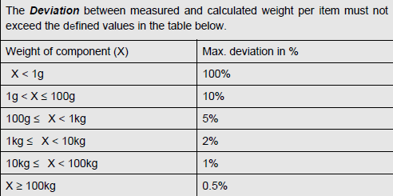

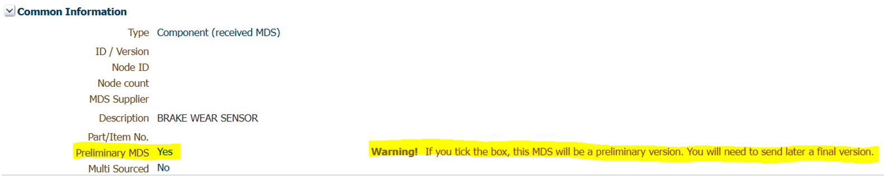
Common MDS Rejection Reasons
10) Weight deviation:
Must stay within defined limits.
(Ref: IMDS Rec 001 Rule 4.2.2.C)
11) Deactivated MDS/modules:
Do not use deactivated MDS/modules unless for legacy or aftermarket parts—ask suppliers for updates.
12) Do not check the Preliminary MDS box:
Submissions with it checked will be rejected and must be resubmitted.
For use by Cummins suppliers

Slide 8
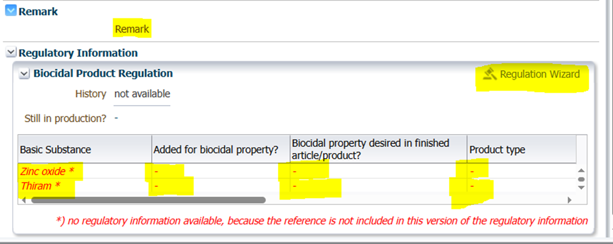

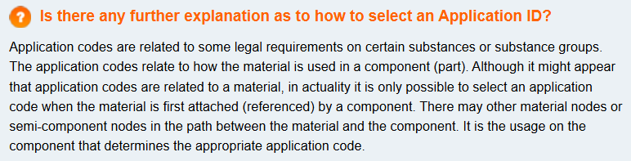
Common MDS Rejection Reasons
13) Biocide Products Regulation:
Certain substances (e.g., Zinc Oxide, Thiram) may be prohibited under biocide regulations. You must indicate in the Regulation Wizard whether such substances are used as biocides in your product and specify their purpose or application in the affected material using “Remark” field, if additional explanation is needed.
14) Declaring Homogeneous Materials:
Each material node must represent a single homogeneous material. Multiple materials should not be grouped under one node—each should be declared separately.
15) Incorrect Application Code Use:
IMDS may suggest an application code, but it's your responsibility to ensure the correct one is used for each substance. A full list of valid application codes is available on the IMDS Public Pages. IMDS Information Pages - MDS Ingredients Screen - IMDS Public Pages
For use by Cummins suppliers

Slide 9
Key FAQs - Submission Requirements
1) New Datasheet Submission:
Submit a new datasheet only if the part number is new or changed.
Revised datasheets must be used for updates like material, weight, substances, application codes, or classifications.
(Ref: IMDS Rec 001 Sec. 3.2.1; CMI Manual 5, 6, 10)
2) Use of Cummins Part Numbers:
Always include the Cummins part number and name in your MDS submissions.
(Ref: CMI Manual Sec. 9, 10)
3) Full Material Disclosure (FMD) Policy:
Cummins requires FMD submission via IMDS or CDX.
Letters of compliance are temporary, as CES 10903 (the list of restricted substances) updates twice a year.
(Ref: CMI Manual Sec. 12)
4) Reportable Substances
All substances in the final product must be reported.
No omissions or assumptions allowed.
(Ref: CMI Manual Sec. 4)
For use by Cummins suppliers

Slide 10
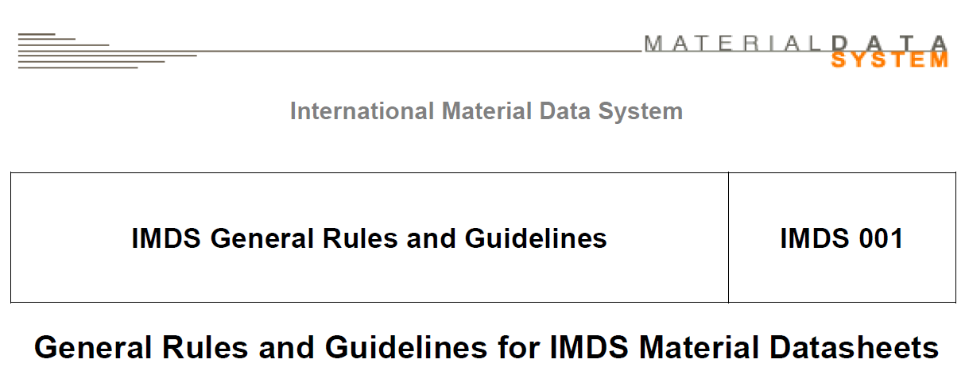
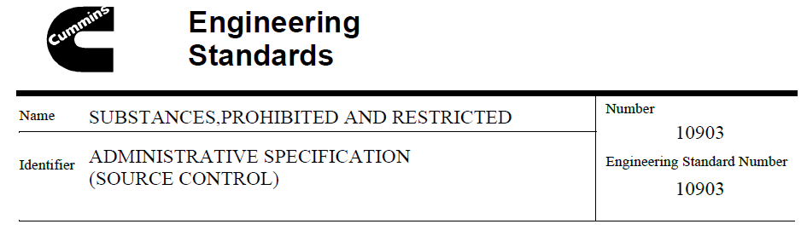
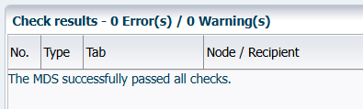
Key FAQs – Submission Process
5) Pre-Submission Checks
Ensure all MDS checks are completed prior to submission (Manual and Automated). Submissions must comply with IMDS/CDX (IMDS Recommendation 001) and Cummins-specific requirements (CES 10903).
(Ref: CMI Manual, Sec 9)
6) Review Timelines
Due to the complexity of some MDS submissions, disposition may take up to 30 days. Plan accordingly to avoid delays.
7) Alternate Submission Methods
Cummins only accepts non-standard product data submissions with prior written approval.
(Ref: CMI Manual)
For use by Cummins suppliers

Slide 11

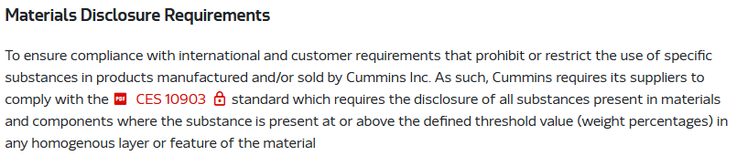
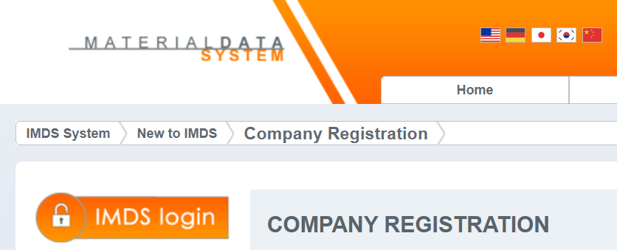
Resources & Support
Links:
Cummins Supplier Portal: Materials Disclosure Requirements and Guide | Supplier Portal
Product Compliance Manual: Cummins Product Compliance Manual
Cummins Engineering Standard (CES10903) –Substances, Prohibited and Restricted Log in | Supplier Portal. If you do not have an account on the Supplier Portal, contact the Supplier Help Desk Contact us | Supplier Portal
IMDS Account Setup: IMDS Information Pages - Company Registration - IMDS Public Pages
IMDS Training Portal: IMDS Information Pages - Tutorials - IMDS Public Pages
Contact: supplier.compliance@cummins.com
For use by Cummins suppliers

