Slide 1


Anthesis Validation
Class D: Common Mistakes
Anyelen Bailey

Slide 2
Presentation Overview
The goal of this presentation is to highlight common mistakes encountered when completing the Anthesis Class D Full Material Declaration (FMD) forms, explain why these errors lead to rejections, and provide practical guidance and best practices to ensure accurate and compliant submissions that are approved on the first try.
Section A: Common Mistakes in the Business Tab
Section B: Common Mistakes in the Product Tab
Section C: Common Mistakes in the Sub Products Tab
Section D: Common Mistakes in the Homogeneous Materials Tab
Section E: Common Mistakes in the Substances Tab
Section F: Data Summary Tab – Final Validation
Read me: Provide summary/goal of what the presentation will cover
Cummins Confidential

Slide 3
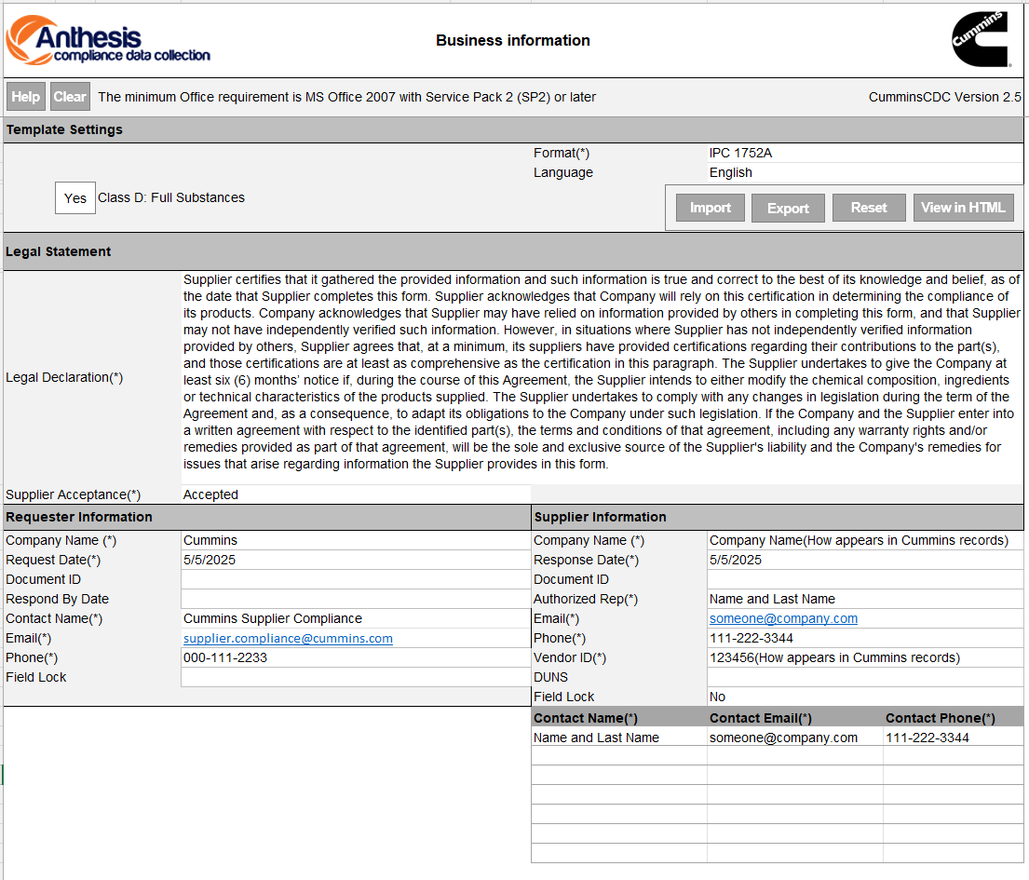

Business Info Tab
When completing the Business tab, it is important to follow the correct steps to ensure that all required information is entered and that the form proceeds without errors.
1
Using an Outdated Version
Mistake: Using an older version of the Anthesis tool that allows selection between Class C and Class D.
Impact: The older version is no longer accepted when only providing class C declaration. Class C submission can lead to rejection of the submission.
Resolution: Always use Anthesis Cummins CDC Version 2.5, where only Class D is available. Immediately discontinue use of previous versions and update all training materials accordingly.
Incorrect Company Name or Vendor Code
Mistake: Entering a company name or vendor code (SIM ID) that does not exactly match Cummins’ official records.
Impact: Mismatched information can result in failed submissions, delays in approval.
Resolution: Always verify that the company name and vendor code (SIM ID) entered in the Business Info tab exactly match the records in Cummins’ internal system. When in doubt, reach out to your Cummins contact for confirmation.
2
2

Slide 4
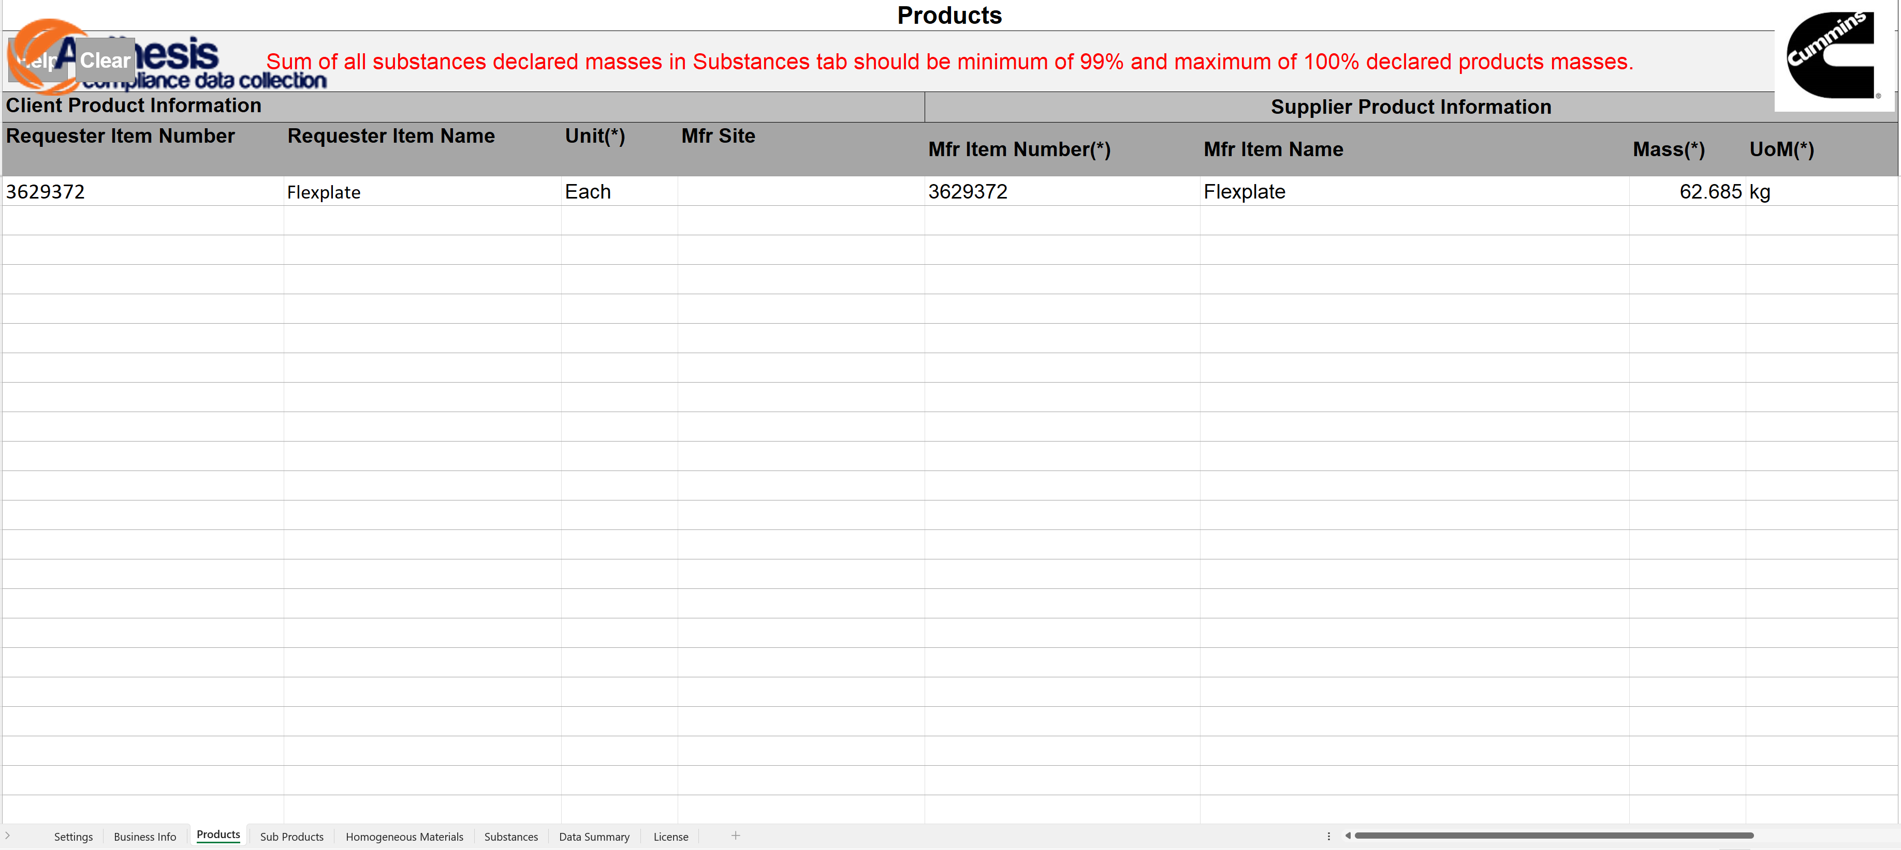

Products Tab
The Product tab is essential for accurately identifying the product being submitted. It's important to enter information correctly to avoid submission issues.
1. Listing Multiple Products
Mistake: Adding more than one product in the Product tab.
Impact: For class D declaration only one product per submission is allowed. Entering multiple products can cause rejection.
Resolution: Always ensure that only a single product is listed in this tab. If multiple products need to be submitted, they must be entered in separate forms. Please make sure item number matches Cummins part number.
2. Incomplete Column Entries
Mistake: Leaving required columns blank (except one noted exception).
Impact: Missing information can result in the submission being flagged as incomplete or rejected.
Resolution: All columns in the Product tab must be filled out completely and accurately, with the exception of the "Mfr Site" (Manufacturer Site) column, which should be left blank unless specifically requested.
3. Unnecessary Completion of "Mfr Site"
Mistake: Filling in the "Mfr Site" field unnecessarily.
Impact: This can cause confusion during validation or delay processing, especially if the site information does not match internal records.
Resolution: Do not fill out the "Mfr Site" column unless you have been explicitly instructed to do so.
3
1
2
2
2
2
2
2
2

Slide 5
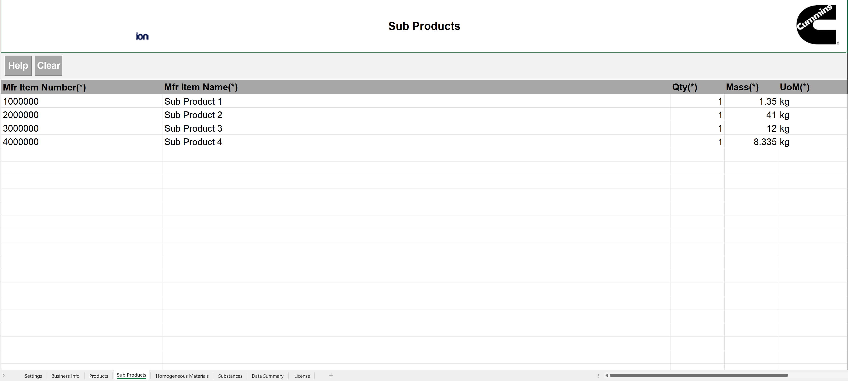




Sub Products Tab
The Sub Products tab breaks down the main product into its individual components.
1. Duplicate Sub Product Names
Mistake: Using the same name for multiple sub products.
Impact: Duplicate names can lead to confusion, data errors, or rejection of the submission due to lack of clarity in the product structure.
Resolution: Ensure that each sub product has a unique and descriptive name that clearly identifies its role or material. If duplicate sub-product are present in the assembly, then update its quantity and enter unit weight of each sub-component (no sum of total quantities). Example product has sub-assembly of 3 bolts each weighing 10 grams then mass for that sub-assembly needs to be 10 grams instead of 30 grams.
2. Incorrect Mass Totals
Mistake: For assemblies without more than one sub-assemblies in quantities, the sum of sub product masses does not match the total mass of the main product listed in the Product tab.
Impact: Mismatched mass values may cause validation errors and raise compliance concerns.
Resolution: Double-check that the total of all sub product masses exactly matches the product mass. Recalculate or adjust individual masses as necessary.
3. Inconsistent Units
Mistake: Using inconsistent units across the document (e.g., grams in one tab, kilograms in another).
Impact: Unit mismatches can cause errors in calculations and may lead to the submission being returned or delayed.
Resolution: Use consistent units of measure across all tabs and fields—preferably matching the unit used in the Product tab. Convert values if needed before entry.
1
3
2

Slide 6
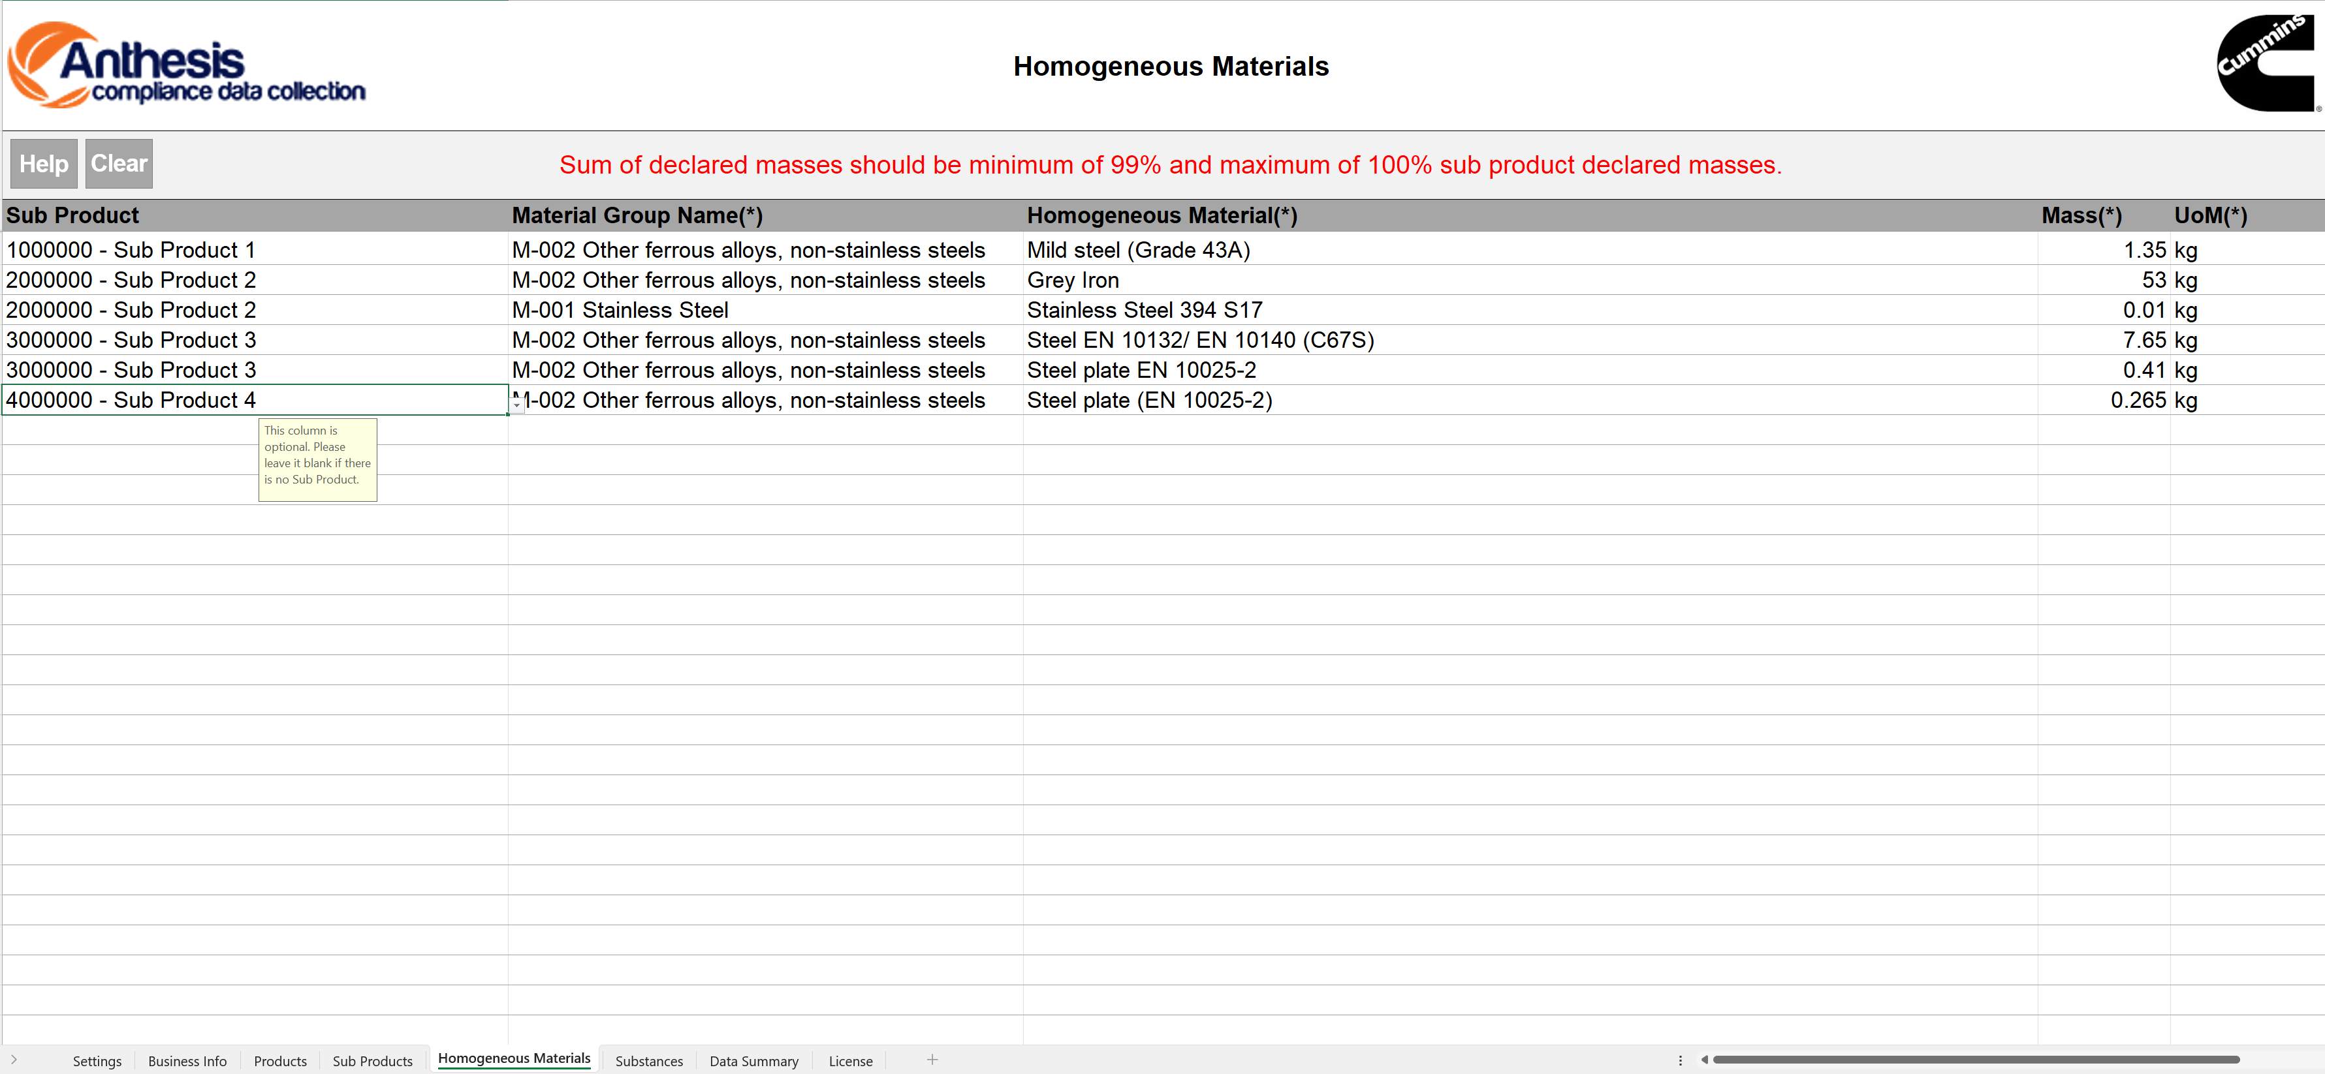



Homogeneous Materials
The Homogeneous Materials tab is used to list and describe all uniform materials within each sub product. It is essential for compliance and material transparency.
1. Mismatched Total Mass
Mistake: The total mass of all homogeneous materials does not match the total product mass from the Product tab.
Impact: This inconsistency raises validation issues and may result in the submission being rejected or delayed.
Resolution: Ensure that the sum of all homogeneous material masses exactly equals the product mass. Cross-check values with those in the Product and Sub Products tabs before finalizing. For assemblies with more than one sub-assemblies in quantity, mass needs to be total weight of that particular sub-assembly. Example product has sub-assembly of 3 bolts each weighing 10 grams listed in the sub products tab then mass for that sub-product in homogeneous material tab needs to be 30 grams instead of unite weight of 10 grams.
2. Material-Level Accuracy
Note: Each homogeneous material should be clearly and accurately defined, matching the breakdown of the sub products.
Best Practice: Use precise naming and ensure alignment with the product’s actual construction.
3. Unit Consistency
Reminder: As with other tabs, maintain consistent units of measurement. If the Product tab uses grams, the Homogeneous Materials tab should also use grams.
1
2
2

Slide 7
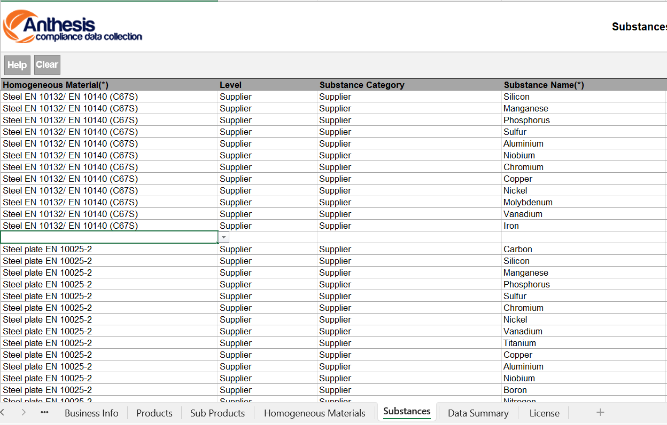
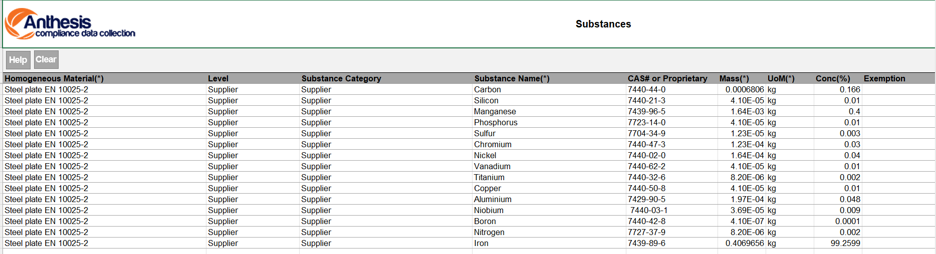
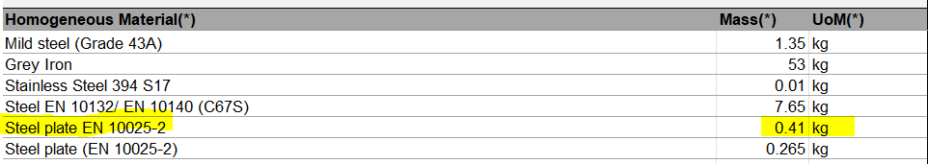
Substances Tab
The Substances tab provides the most detailed level of material reporting. Every field must be completed accurately to meet compliance and regulatory requirements.
1. Blank Spaces Between Columns
Mistake: Leaving empty cells or blank columns between entries.
Impact: Incomplete entries can cause data validation errors and disrupt automated processing.
Resolution: Fill in all required fields, and do not leave blank spaces between columns. If a field is not applicable, use a placeholder like "N/A" only if permitted.
2. Missing or Incorrect CAS Numbers
Mistake: Failing to provide a CAS (Chemical Abstracts Service) number or entering an incorrect one.
Impact: Missing or invalid CAS numbers may result in rejection due to regulatory non-compliance.
Resolution: Verify and enter the correct CAS number for each substance. Use an official source or reference database to ensure accuracy.
3. Incorrect Concentration Totals
Mistake: Substance concentrations do not add up to 100% for a given homogeneous material.
Impact: This will trigger a submission error and requires correction before approval.
Resolution: Ensure that the sum of all substance concentrations equals 100% for each homogeneous material entry.
4. Mass Discrepancy
Mistake: The total mass of substances does not match the mass of the corresponding homogeneous material.
Impact: This inconsistency compromises the integrity of the material breakdown and causes rejection.
Resolution: Confirm that the total mass of all listed substances aligns with the mass of the homogeneous material they belong to.
1
2
3
4

Slide 8
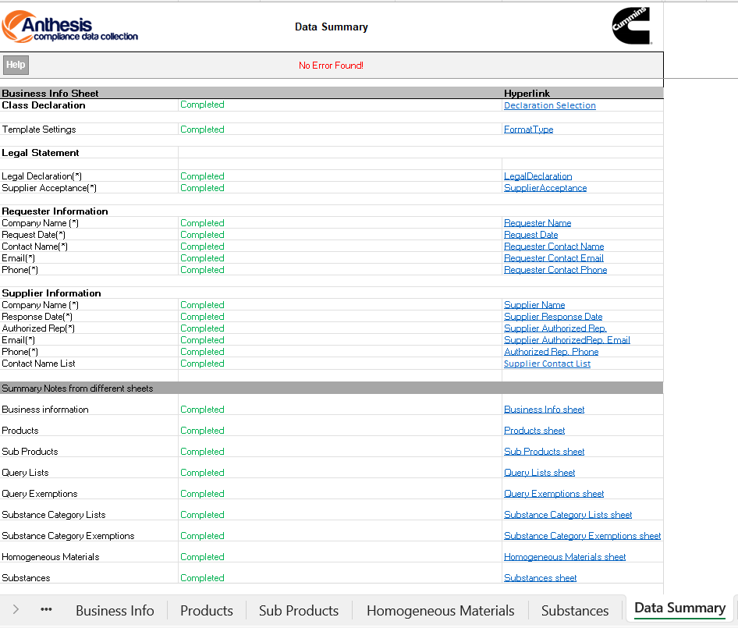


Data Summary
1
The Data Summary tab provides an automated overview of the entire Anthesis form and serves as your final checkpoint before submission.
1. "No Error Found" Confirmation
Goal: Once all tabs are filled out correctly, the top of the Data Summary tab should display “No error found.”
Importance: This message indicates that the form is structurally complete and that major validation checks have passed.
Tip: Always review this tab before submission. If errors are listed, return to the relevant tab(s) and correct the issues.
2. All Fields Should Say "Completed"
Mistake: Fields marked as "Incomplete" or highlighted in red/yellow.
Impact: These indicators mean required data is still missing or incorrect, which can cause rejection or delays.
Resolution: Ensure every row in the Data Summary tab displays “Completed” and is highlighted in green. This confirms that each section has passed the internal checklist.
3. Best Practice
After correcting any issues, recheck the Data Summary tab to ensure all updates are reflected.
Save and back up your completed form before submission.
2

Slide 9
Q+A
Supplier.compliance@cummins.com

Slide 10



